Slide 1
Jacoby Transfers
And Super Accepts
Colorado Front Range Bridge, Dec 2020

Slide 2
Assumptions
1NT is 15-17
2D or 2H are “transfers”
Responder has 5 or more cards
in the suit directly above

Slide 3
Why Transfers?
Strong hand stays concealed
Favorable lead into big hand
Safely stop at 2 level

Slide 4
A
Responder
T x x x x
x
K J x x x
x x
Opener Responder
1 NT 2 H
2 S ??
Commentary:
PASS is your bid. Game is out of reach. Just let partner play in 2S and cheer.

Slide 5
B
Responder
x x
K J x x x
K x x
Q x x
Opener Responder
1 NT 2 D
2 H ??
Commentary:
2NT
Balanced hand, 5 hcpts, 5 card suit. Invite. Parter can pass, bid 3H, 4H or 3NT.

Slide 6
C
Responder
A x x
Q T x x x x
x
J x x
Opener Responder
1 NT 2 D
2 H ??
Commentary:
3H
With a 6 card suit, singleton,
invite to game. Partner will
expect 6 trump (Hearts)

Slide 7
D
Responder
K J x x x
A x
Q x x
T x x
Opener Responder
1 NT 2 H
2 S ??
Commentary:
3NT
Don’t invite with game going
Values (10+) but offer partner
A choice of 3NT or 4S

Slide 8
E
Responder
K J T x x x
x
A J x
T x x
Opener Responder
1 NT 2 H
2 S ??
Commentary:
4 Spades
Another, don’t invite with game going values (10+) and you expect a fit with partner having 2+ spades.

Slide 9
F
Responder
K J x x x
A K x x x
x x
x
Opener Responder
1 NT 2 H
2 S ??
Commentary:
3 H Show another 5 card suit and tell partner you have game going values (10+). Trust partner to pick between 4H, 4S or 3NT

Slide 10

Super Accepts
With the right hand…
Opener can super accept
Responder is asked to
re-evaluate his hand

Slide 11
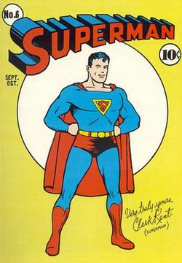
Original Super…
With 17 points
4 cards in target suit
Jump one level
1NT - 2H - 3S
1NT - 2D - 3H
This Photo by Unknown Author is licensed under CC BY-SA

Slide 12
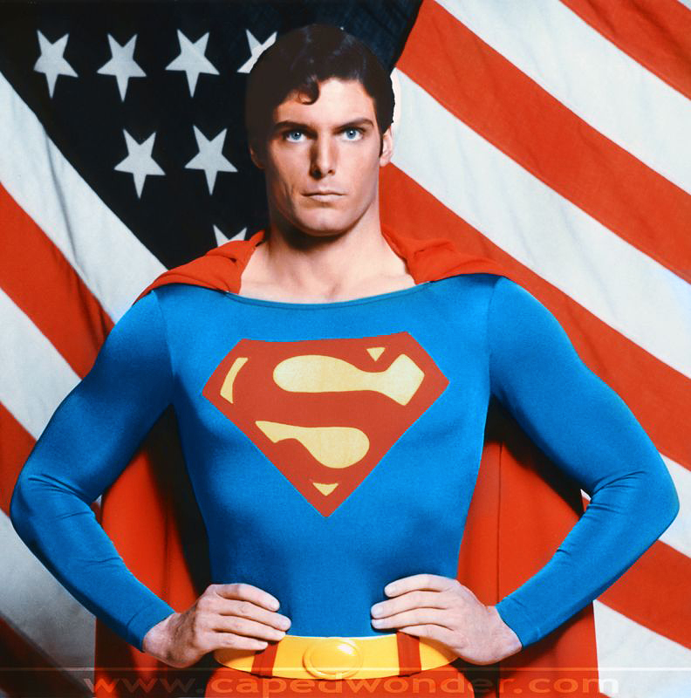
New and Improved…
With 17 points
3 trump
Opener bids 2NT!
responder can
retransfer

Slide 13

What if Opps Interfer?
This Photo by Unknown Author is licensed under CC BY-SA

Slide 14
What if Opps Interfer?
Discuss with partner – always a really good idea
Transfers can be ON if space is available at 2 level
Double could mean “Stolen Bid”
Mark your convention card

