Slide 1

MBC Introduction to Bridge
Bridge Lessons for Beginners and Returning Players
Each Tuesday from 2nd Sep 2025: 2:30 – 4:30
127 St Vincent Street Ulladulla
Cost $20 for Paul Marston’s Introduction to Bridge
Presenters Rae Duffy; Sue Myers-Bateman; John Reid
Version 2.05

Slide 2

MBC Introduction to Bridge – Presenter Notes
In general this document follows the content as presented in Paul Marston’s book. In the first three chapters, some content is presented in slightly different order to the book. This was to try to address one common issue amongst beginners, being which role the content related to (ie opener or responder for example). So most of chapter 2 relates to Opener’s first bid; most of chapter 3 to Responder’s first bid and most of chapter 4 to Opener’s second bid. Other chapters in this document cover the same content as the equivalent chapter in the book
The latest version of the text we are using is based on a very simplified Two Over One. After teaching that with the last class and speaking with other educators, I have elected to revert to Standard. Most of the club members use Standard for bidding; so it simplifies ongoing integration and learning. There are very few changes with the text, which I will highlight. The major changes are that 1NT reverts to a range of 6-10; and a first SUIT bid by responder at the two level promises 10+ HCP and is NOT game forcing.
I have tried to provide at the end of each chapter, additional resources for students relevant to the concepts covered to that point. I generally provide these in an email after the lesson (as most attendees will not have access to the soft version of this document).
In the book, each chapter has four example hands to play, related to the content. I have created these as .PBN files which are available on the clubhouse computer. In addition I have downloaded the NSWBA practice hands which cover similar content – also available on the clubhouse computer.
The content for most chapter’s can be covered in about one hour, leaving an hour for card play.
The latest version of this document can be downloaded from https://docs.google.com/presentation/d/11y_WC-7kcoSR5VqOmf4-2ysa2MdFYprz/edit?usp=drive_link&ouid=111006996788244744891&rtpof=true&sd=true

Slide 3

MBC Introduction to Bridge – Introductions
Please introduce yourself
Why Bridge ? What have you heard about bridge ?
Any experience with bridge or other card games ?
A little something about you ☺
Need a book ? Contact details please (sign up sheet)

Slide 4

MBC Introduction to Bridge – About us
Mollymook Bridge Club – plays in Ulladulla
New and returning players always welcome
Regular Beginner and Improver training and supervised sessions
Friendly relaxed club environment
Bridge games five times weekly, with social games Thursday evening and Saturday afternoon. The club also organises quarterly online games which run for six weeks and supervised play sessions following each introductory class
Regular social events: pizza nights, wine and cheese, BBQs, dinners and Christmas party
Around 110 members
Lots more on our website: http://bridgewebs.com/mollymook (or scan the code to the left with your phone)
Milton Bridge Club – also plays in Ulladulla. So where the heck is the Ulladulla Bridge Club ?

Slide 5
MBC Introduction to Bridge – About this course
These notes follow the chapters in Paul Marston’s book (sixth edition). I would recommend reading the relevant chapter before each lesson.
When | What
Week 1 | Ch1. The play of the cards. Introduction to card play
Week 2 | Ch2. The bidding. Introduction to bidding
Week 3 | Ch3. Fit then game. Introduces distribution points and responder hand evaluation.
Week 4 | Ch4. Searching for a fit in a major. Opener’s rebids
Week 5 | Mid-ish term review and play some cards
Week 6 | Ch5. Opener has a balanced hand: opening no trumps
Week 7 | Ch6. They open the bidding: overcalling team
Week 8 (opt) | Appendix: More advanced bidding. Opening 2s. Transfers. Stayman.
Each lesson includes a collection of additional resources which you might find valuable. We will send out an email after each lesson with a brief review and the links to the additional resources.
Notes:
Three basic elements in bridge: bidding, declarer play and defence.

Slide 6

MBC Introduction to Bridge – Ch1. Play of the cards: overview
This week we work through Chapter 1 of the book. We talk mostly about how the cards are played, and we briefly talk about bidding.
Playing the cards
Card ranking
The order of play, who plays when
Declarer, dummy and defenders
What is a trick
Following suit and what to do if you can’t
Trumps
Opening lead options
Complexity: Low
Importance: Medium
Notes:
The system we are teaching is one of the most popular in the world – standard 5 card major - and is the standard system for MBC (albeit with many minor differences). There are a plethora of other systems around
No jokers in bridge.
Demonstrate using a bridge board – cards; and the dealer.
Unlike 500 for example, after passing you can re-enter and continue bidding in the next round

Slide 7
MBC Introduction to Bridge – Ch1. Play of the cards: pt 1
Rules vs Agreements vs Best Practice
Card ranking (highest to lowest)
  – Ace King Queen Jack 10 9 … 2
Player identification
  - North, South, East and West
A deal is comprised of
  1) your evaluation of your hand;
  2) a bidding round (‘the auction’ covered in more detail in week 2);
  3) the play of the cards; and
  4) scoring the result – most of which is done automatically (covered in more detail later).
  - Bidding and card play both proceed in a clockwise direction (looking down) – starting with?
What is a trick ?
  each player plays one card from her hand in clockwise order. The trick is won by the highest card in the suit that was led (unless a trump is played).
  Each player has 13 cards, so there are 13 tricks in a deal (also called a hand or a board);
  After the winner is determined, your card is then placed face down in front of you – orientation shows the winner.
Concepts: System; Suit Order; Card Ranking; Order of play; Tricks
Notes:
Differences with say 500
Rubber (or contract) bridge vs Duplicate bridge.

Slide 8
MBC Introduction to Bridge – Ch1. Play of the cards: pt 2
Any questions before we proceed ?
How is the winner of each trick determined ?
  - highest card of the suit led, or highest trump played if this is a trump contract
  - It doesn’t matter which partner wins – you play as a team
  - can one renege ? Inevitably - but you may not :p
  - what if you can’t follow suit ? Discard or trump.
What is the contract ?
  - the final bid in an auction
  - determines the trump suit (or no trumps)
  - determines the minimum tricks declarer needs to win
What does it mean to establish one or more tricks
Generally which hand plays high and which plays low?
Hand evaluation
  - What is an honour ? What about a ten ?
  - Ace (4); King (3); Queen (2); Jack (1).
  - Thus there are a total of 40 points in the deck
  - what is a good hand, no trumps vs trumps
  - A word about shape
What is the winning card in each of these tricks?
Concepts: Contract; Trumps; Declarer; Discards; HCP; Defenders; Hand evaluation; Dummy; Honours
Notes:
A call is a pass, a bid, a double, or a redouble.
NOTE that suit symbols on this slide may not resolve on other devices

Slide 9
MBC Introduction to Bridge – Ch1. Play of the cards: pt 3
Any questions before we proceed ?
Trumps – what are they, how many do you want ?
  13 cards in each suit. Seven for a majority, but eight is much more desirable (referred to as a fit)
Dummy – what may she say ? (today she may ask questions)
What to lead ?
NT: partners bid suit; top of sequence; low from a long suit with honour; high spot card from rubbish
T: non-trump singleton; partners suit; top of sequence; low from a long suit with honour; high spot from rubbish
What do you lead: a+b = NT; c+d=Spades
Any questions ?
Let’s play some practice hands (see next slide)
Additional Resources
Introductory: Peter Hollands Learn to play bridge: https://youtube.com/watch?v=idqlZoL5NKI
Opening Leads: https://bridgensw.com.au/wp-content/uploads/2024/11/BNSW-Play-Mini-Unit-D1-Leads-1.pdf
Opening Leads (advanced): https://www.abf.com.au/teaching/speakers/IshmaelDelmonteOpeningLeads.pdf
Declarer Play - Drawing Trumps: https://bridgensw.com.au/wp-content/uploads/2024/11/BNSW-Play-Mini-Unit-6-Drawing-Trumps.pdf
Practice Declarer Play: Solitaire minibridge: https://www.acbl.org/minibridge/
Practice Declarer Play: Bridge Base Online: https://bridgebase.com (more relevant after week two)
( a ) | ( b ) | ( c ) | ( d )
♠ 8 ♥ A 9 2 ♦ K Q 7 6 2 ♣ 9 8 6 2 | ♠ A 9 8 ♥ K 4 3 ♦ 5 4 ♣ J 9 4 3 2 | ♠ 8 7 4 2 ♥ 2 ♦ Q 6 5 3 ♣ Q J 4 2 | ♠ 7 3 2 ♥ J 8 7 ♦ 9 8 7 4 ♣ 7 4 3
Notes:
Before you do *anything* else, remove your cards from the board and count your cards face down.
Spot or pip cards
NOTE: opening leads should be followed each time you are opening a new suit (ie it’s the first lead made by anyone for that suit)
A word of warning about bridge resources. Bidding changes quickly over time – 13 to open, then 12, now 11. 1NT: 16-18; 15-18; 15-17.

Slide 10
MBC Introduction to Bridge – Ch1. Opening Leads
Why do our opening leads differ when we are defending a trump contract versus a no trump contract ?
In no trumps:
We are trying to establish a long suit
In trumps:
We are unlikely to be able to establish a long suit – they will just trump us eventually
We may be able to get a ruff (trump in) on one of our short suits
Trump Suit opening leads
Partners bid suit (if she made a bid).
A singleton (if we have some trumps to ruff the next lead – but not trumps ☺)
Top of an honour sequence (two or more touching honours eg A from AKxx, Q from QJxx etc)
Low from an honour (ideally 4th); but not Ace. Why ?
No Trump opening leads
Partners bid suit (if she made a bid)
Top of an honour sequence (preferable 3 or more touching honours with a suit of at least four cards eg J from J109xx; K from KQJx
4th of our longest suit with an honour ( can by an Ace)
COUNTER INDICATED
Their bid suits
Remember: leading a low card says to your partner that you want that suit returned.
Notes:
NOTE: our agreements for opening leads should be followed each time you are opening a new suit (ie it’s the first lead made by anyone for that suit)

Slide 11
MBC Introduction to Bridge – Ch1. Play of the cards: who’s on first?
Actor | Determined by
Who bids first | The dealer bids first, then clockwise
Who’s the declarer | The person on the side who won the auction, who first bid the contract suit
Who’s the dummy | The partner of the declarer. Her hand goes down after the first lead
Who are the defenders | The team which did not win the contract
Who leads | The first lead is made by the defender on declarer’s left. After that, the winner of the previous trick leads to the next trick
How do … | Thus:
I play my card to a trick | At your turn, place the card face up in front of you (ie not in the centre of the table). Don’t touch your cards until it is our turn to play
es dummy put down her hand | The four suits are laid on in four columns in front of you, in descending order with the highest ranked card nearest you. In a trump contract, the trump suit should be placed furthest to your right
I place my cards after a trick is played | After each trick, turn over your card in front of you (ie it is not face down). If you won the trick, the long edge points towards your team, if you lost the trick the long edge points towards the opponents.
I hold these damn cards | Chuckle, it’s a good question. I usually set up my hand with alternating colours. I arrange each suit in ascending suit order. To fan the cards, hold them in a stack in your preferred hand between thumb and forefinger and use the other hand to slowly fan them
Notes:
Use four boards from BNSW-Beginner-02-NT-play and four boards from BNSW-Beginner-03-Suit-play

Slide 12

MBC Introduction to Bridge – Ch1. Play of the cards: review
Concept | Comment | Concept | Comment
System | Standard five card major | Dummy | Declarer’s partner: no play + almost no talk
Suit order | Bidding: C < D < H < S < NT | Defender
Card ranking | A K Q J T 9 -> 2 | Discard | Can’t follow suit
Order of play | Clockwise | HCP | High Card Points
Trick | All players play one card | Hand evaluation | A=4;K=3;Q=2;J=1
Contract | Last bid followed by three P | Honours | A K Q J (10 ?)
Declarer | Person who first bid contract suit. First lead to her left. | Opening Leads
Concepts:

Slide 13
Suit Order (ascending) Clubs Diamonds Hearts Spades No Trumps | Opener | HCP Ace = 4 King = 3 Queen = 2 Jack = 1
Advancer | Opening Leads Partners bid suit Top of sequence Low from honour Defending Trumps: Singleton Second highest of rubbish Defending NT: your partnerships long suit | Overcaller
 | Responder

Slide 14
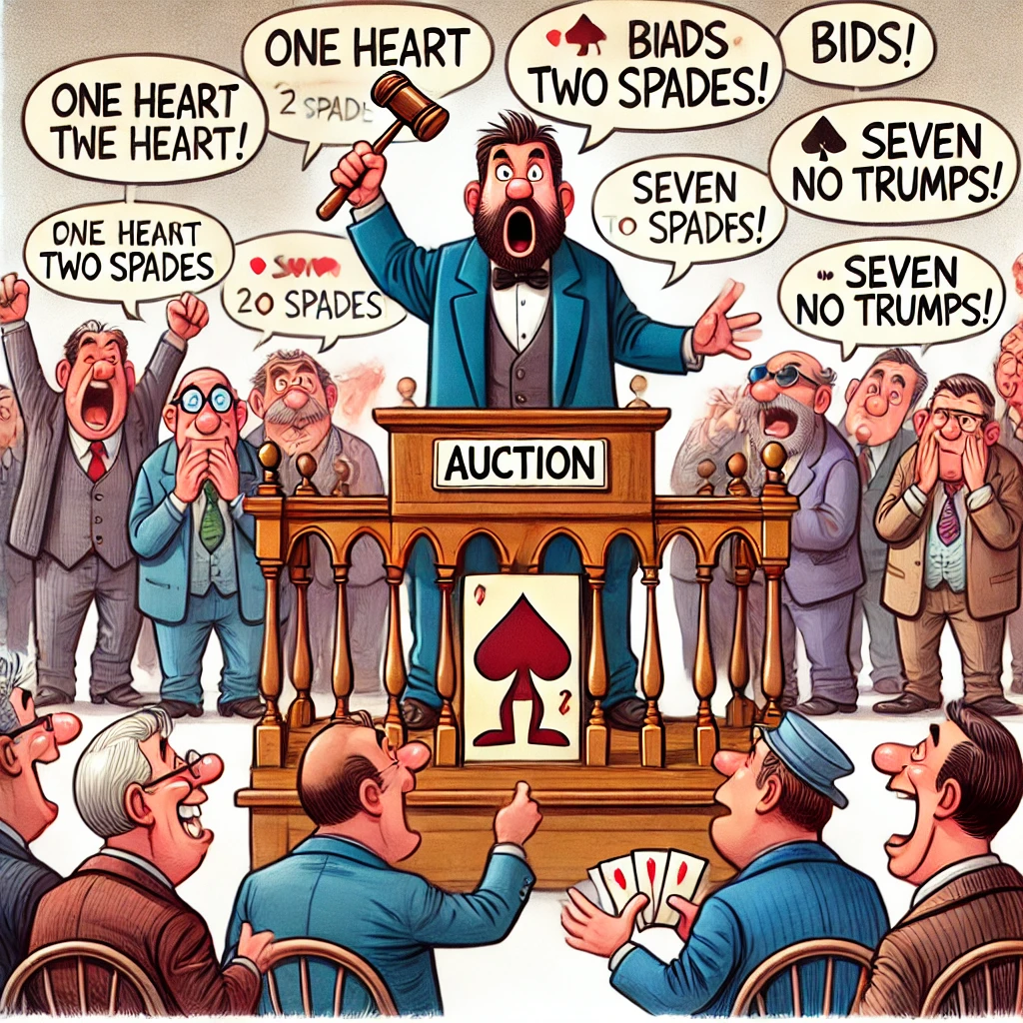
MBC Introduction to Bridge – Ch2. Bidding: overview
This week we look at content in Chapter 2 of the book. We dip our toes into bridge bidding:
Major suits and Minor suits explained
The order of bidding (who goes first etc)
What do you need to make the first bid and what should you bid
Supporting your partner’s bid suit
What does it mean to find a fit
When to play in no trumps
We will take our first look at our own system cards
Any questions before we proceed ?
PS: to better explain the (heee-larious) visual pun; the entire round of bidding is referred to as the Auction :p
Complexity: Medium
Importance: High
Card Play Tips
Unless you have a reason not to, draw trumps as a first priority
Notes:
Draw on the board 1C (20)1D (20) 1H (30)1S (30)1NT (40) 2C (40) 2D (40) 2H (60) 2S (60) 2NT (70) 3C 3D 3H 3S 3NT (100)
A = 4; K = 3; Q = 2; J = 1 (10 HCP each suit; 40 HCP in the deck)
Hand out system cards

Slide 15
MBC Introduction to Bridge – Ch2. Bidding: What’s our Role
Just as there are four players in a game of bridge, there are also four roles in the bidding round:
The Opener is the first person to make a bid (a bid is a call other than Pass)
The Opener’s partner is called the Responder
Together this pair is usually referred to as the Opening pair or Opening team.
It is very important to know your role when you are bidding as the bidding agreements are different for each role.
This lesson will focus principally on our bidding agreements for the Opener role, and some of our agreements for Responder role.
The other pair may be called the Overcall team or the Defence.
The first person to make a call on the Overcall team is called the Overcaller, and her partner is referred to as the Advancer. These roles are discussed in more detail in week 7 ☺
Concepts: Bidding roles
Notes:
Note that passing is not referred to as a bid. This is a call (as also are double and redouble)

Slide 16
MBC Introduction to Bridge – Ch2. Bidding: the Opener
Suit order for bidding
  from lowest to highest (see sidebar) Clubs < Diamonds < Hearts < Spades <No Trumps
  Each subsequent bid must be higher than the previous bid
Bidding starts from 1. For a 1 level contract you need to win 7 tricks; 2 -> 8 tricks … 7 -> 13 tricks
Major and minor suits. How are points scored (Caution: the word points has multiple meanings)
  - either by making your contract or bringing down your opponents in their contract
  - you score more points for making a major contract than making a minor contract at same level
  - you score the most points in a no trump contract at the same level
When to open the bidding
  - 12+ HCP. Five card (or more) major (M) first priority; otherwise longer minor (m)
What is a fit ?
  partnership has 8+ cards in a suit
Bidding promises a certain length in a suit – the strength is not necessarily in that suit
Any Questions ?
A = 4
K = 3
Q = 2
J = 1
( a ) | ( b ) | ( c ) | ( d )
♠ Q 7 6 5 3 ♥ 5 ♦ A K Q 3 ♣ J 4 3 | ♠ A J 8 4 ♥ A K 2 ♦ Q 9 8 6 ♣ 7 6 | ♠ K Q 6 3 2 ♥ 8 5 ♦ 2 ♣ K 10 7 6 3 | ♠ A Q 6 ♥ A K J ♦ 6 4 2 ♣ K Q 4 2
How would you bid these hands – you are first to bid
(p16 2.1)
Let’s play some practice hands – bidding only
Concepts: Major; Minor; Fit; Opener
Notes:
Q: What is the purpose of bidding ?

Slide 17
MBC Introduction to Bridge – Ch2. Bidding: the Responder
Responder’s (opener’s partner) bid
  - pass with less than 6 points. Otherwise with six or more points:
  - support partners major suit opening with 3+ in her major (ie we have a fit)
  - bid a 4+ card major (M) at the one level
When to bid no trumps
  no major fit and some coverage in all suits
Just as it was with the Opener’s bidding, bidding promises a certain length in that suit, not necessarily strength in that suit.
Keep the bidding low until you have a fit
Review the bidding example on page 17 of the text – with all players bidding
Any Questions ?
( a ) | ( b ) | ( c ) | ( d )
♠ K 8 7 6 ♥ Q J 6 ♦ A Q 5 ♣ 9 3 2 | ♠ 8 6 4 ♥ K J 2 ♦ K 10 4 3 ♣ A Q 2 | ♠ K 6 3 2 ♥ 9 7 ♦ J 9 6 5 2 ♣ 8 6 | ♠ J 6 4 ♥ 4 2 ♦ A Q J 10 4 ♣ 10 6 2
Partner opens 1♠ - what do you respond ?
Concepts: Responder
Notes:
Concept of a stopper

Slide 18
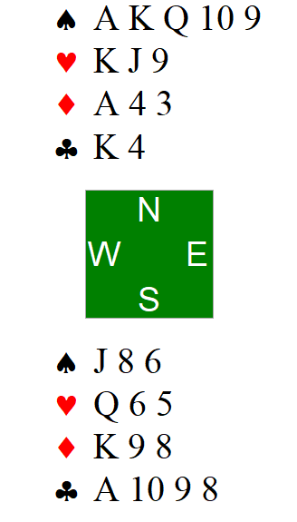
MBC Introduction to Bridge – Play of the Cards. Trumps pt 1
Make a plan.
Contract is 4S by North.
East leads a small club. How do you plan on playing this hand ?
Notes:
If you have clear winners in the off suits – generally play trumps first.

Slide 19
MBC Introduction to Bridge – Play of the Cards. Trumps pt 1
Make a plan.
In a trump contract, you usually start off by counting your losers. Start with the hand with the most trumps; and then go suit by suit, using the cards from both hands for that suit and count how many high cards are missing.
So using North’s hand we have:
No losers in spades (the jack is in souths hand)
One loser in hearts (we are missing the Ace)
One loser in diamonds (we have Akx)
And no losers in clubs (we have AK)
Now count your trumps. How many do the opponents have. How are they likely to split ?
In trumps, if we have enough winners in side suits, it is best to draw trumps first and then play our winners in the side suits (ie we don’t want our opponents to trump in).
Plan = draw trumps; win off suit tricks. (losing one heart and one diamond)
Notes:
If you have clear winners in the off suits – generally play trumps first.

Slide 20
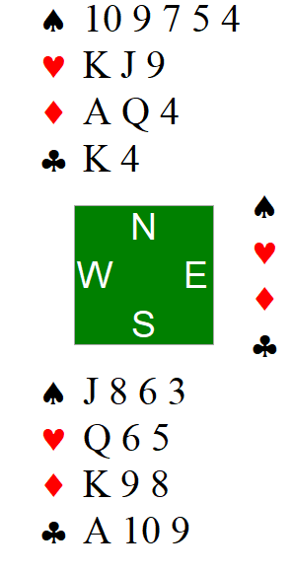
MBC Introduction to Bridge – Play of the Cards. Trumps pt 2
Make a plan.
Contract is 2S by South.
West leads a small club again ☺ how do you plan on playing this hand ?
Notes:
If our hand are strong in the off suits – play trumps first !! Regardless of our trump holding strength

Slide 21
MBC Introduction to Bridge – Play of the Cards. Trumps pt 2
Make a plan.
Trump contract again – count your losers
So using North’s hand we have:
In spades we have three losers (AKQ)
One loser in hearts (we are missing the Ace)
No losers in diamonds (we have AKQ)
And no losers in clubs (we have AK)
Now count your trumps. How many do the opponents have. How are they likely to split ?
Despite those losing trumps; we still have great off suit winners – so get rid of opponents’ trumps (yes, we will lose a few tricks) *before* being tempted to take your off suit winners.
NOTE: though we count three losers in spades, how many do you think we are likely to lose ?
Plan = draw trumps (losing three rounds); then play off suit tricks (losing a further one)
Notes:
If our hand are strong in the off suits – play trumps first !! Regardless of our trump holding strength

Slide 22
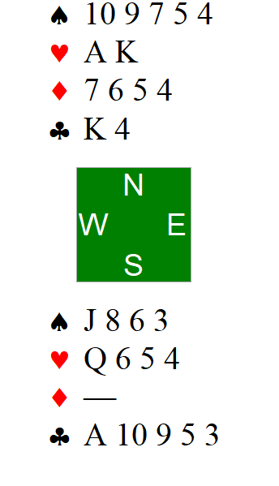
MBC Introduction to Bridge – Play of the Cards. Trumps pt 3
Make a plan.
Contract is 4S by North
East leads a small club – what is the plan ?
Notes:
Don’t start playing trumps until you have made a plan – should we look for ruffing opportunities ?

Slide 23
MBC Introduction to Bridge – Play of the Cards. Trumps pt 3
Make a plan.
Trumps again – lets count our losers
So using North’s hand we have:
Three losers in spades (AKQ)
No losers in hearts
Four losers in diamonds
And no losers in clubs (we have AK)
Now count your trumps. How many do the opponents have. How are they likely to split ?
In trumps, if we have a lot of losers in our side suits; we want to find a way to use our trumps to ruff those losers. So now, we *don’t* want to start off by leading trumps, but we want to make our ruffs early.
How are the diamonds likely to split ?
Is there another way to get rid of a losing diamond ?
How will we get back to the north hand ?
Plan = win in North, D ruff, heart to A, D ruff; H to K; D ruff; AC; xC ruff; D ruff. Draw trumps.
Notes:
Don’t start playing trumps until you have made a plan – should we look for ruffing opportunities ?

Slide 24
MBC Introduction to Bridge – Ch2. Bidding: additional resources
( a ) | ( b ) | ( c ) | ( d )
♠ A J 6 2 ♥ Q 9 2 ♦ 9 3 2 ♣ 9 4 3 | ♠ 9 8 5 ♥ Q 10 7 2 ♦ 3 2 ♣ K J 8 5 | ♠ K J 9 7 5 ♥ A Q J 7 ♦ 2 ♣ K 3 2 | ♠ J 3 ♥ A K J 7 6 ♦ A J 5 4 ♣ 4 3
Partner opens 1♣ – what do you respond ?
(pg 20 #2)
( a ) | ( b ) | ( c ) | ( d )
♠ 8 ♥ A 9 2 ♦ K Q 7 6 2 ♣ 9 8 6 2 | ♠ A 9 8 4 ♥ A K 4 ♦ 5 4 ♣ J 4 3 2 | ♠ J 8 7 4 2 ♥ 2 ♦ Q 5 ♣ A K Q J 4 | ♠ 7 3 ♥ A J 8 7 ♦ A Q J 9 4 ♣ 7 4
You are first to bid – what do you call ?
(pg 20 #1)
Lets play some practice hands
Additional Resources
Bidding: Peter Hollands learn bridge bidding in 5 minutes: https://www.youtube.com/watch?v=LsHEnTdMh7I
Declarer: planning https://bridgensw.com.au/wp-content/uploads/2024/11/BNSW-Play-Mini-Unit-0-Declarer-Planning-1.pdf
Bidding practice SAYC Bridge: http://www.saycbridge.com/bid/

Slide 25
Suit Order (ascending) Clubs Diamonds Hearts Spades No Trumps | Opener To bid needs 12+ HCP major: 5+ suit minor: 3+ suit Opener HCP Ranges 12-15: Minimum Rebid 16-18: (invitational) Jump Rebid 19+: Game | HCP Ace = 4 King = 3 Queen = 2 Jack = 1
Advancer Discussed in week 7; but for now, assume same as responder | Opening Leads Partners bid suit Top of sequence Low from honour Defending Trumps: Singleton Second highest of rubbish Defending NT: your partnerships long suit | Overcaller Discussed in week 7; but for now, assume same as opener
 | Responder To bid needs 6+ pts Support partner’s M: 3+ suit Bid new suit (1x): 4+ suit Responder general guide 6-9: minimum 10-12: invitational (strong) 13+: game
Notes:
After reviewing this slide – especially the responder general ranges; go back and review the questions in the previous slide

Slide 26
MBC Introduction to Bridge – Ch2. Bidding: review
Concept | Comment | Concept | Comment
Major Suit | Spades or Hearts | Minor Suit | Diamonds or Clubs
Opener | Person who makes the first bid | Responder | Opener’s partner
Overcaller | First opponent to bid | Advancer | Overcaller’s partner
Fit | 8+ cards in a suit
Concepts:

Slide 27

MBC Introduction to Bridge – Ch3. Fit then Game: overview
This Week we go through Chapter 3 of the book – it is mostly about the responder’s role and how to bid when you find a fit:
Bidding
Responder’s bidding when we have a fit
Responder’s bidding with no fit
Once we have a fit, both players should re-evaluate their hands
What is Game and why should we bid it
How do we account for shapely hands in our bidding system – distribution points and total points
The concept of a limit bid
Complexity: Medium
Importance: High
Card Play Tips
Lead towards your honours
Notes:
A note about our library
Invite the challenge: “How important is this for me, now?”

Slide 28
MBC Introduction to Bridge – Ch3. Wk2 Review. The role of Opener
Your partner opens with the following bids – what can you infer
Bid | Promises (HCP, suit) | *Probably* Denies
1♣
1♦
1♥
1♠
1NT
Concepts: Shortage pts; distribution pts
Notes:
Refer to the book pg 26
Distribution points versus shortage points

Slide 29
MBC Introduction to Bridge – Ch3. Wk 2 Review. The role of Opener
Your partner opens with the following bids – what can you infer
Bid | Promises (HCP, suit) | *Probably* Denies
1♣ | 12+ HCP; 3+♣ | 5+♥ ; 5+♠
1♦ | 12+ HCP; 3+♦ | 5+♥ ; 5+♠
1♥ | 12+ HCP; 5+♥ | 5♠ ?
1♠ | 12+ HCP; 5+♠ | 5+♥ ?
1NT | Week 6 ☺
Notes:
With 5 5 in the majors – which major should you generally bid first and why

Slide 30
MBC Introduction to Bridge – Ch3. You have a match set. Can you get game ?
♠ A J 7 6 2 ♥ 4 ♦ A 10 4 ♣ A 5 3 2
You open 1 Spade; and partner bids 2 Spades – can you win 10 tricks ?
♠ A K Q J 7 2 ♥ 4 ♦ A K 10 4 ♣ A 3 2
You open 1 Spade; and partner bids 2 Spades – can you win 10 tricks ?
♠ A K Q 7 2 ♥ 4 ♦ K 10 4 ♣ A 3 2
You open 1 Spade; and partner bids 2 Spades – can you win 10 tricks ?
Notes:
Tennis pun btw :p
Twenty five points to make game

Slide 31
MBC Introduction to Bridge – Ch3. Responder’s bids with fit
NB: You may only count shortage points once you have found a fit
You may count points for each suit which has a shortage (but only in a suit contract)
# Cards | Term | Shortage Pts
2 | Doubleton | 1
1 | Singleton | 3
0 | Void | 5
Add your HCP and your shortage points to get Total Points (TP)
( a ) | ( b ) | ( c ) | ( d )
♠ A K 8 ♥ 4 3 ♦ Q 8 7 6 3 2 ♣ 9 6 | ♠ 5 4 3 2 ♥ 9 ♦ K J 4 2 ♣ J 8 7 4 3 | ♠ K Q J ♥ A J 3 2 ♦ 10 9 8 5 ♣ K 8 | ♠ J 8 5 3 2 ♥ Q ♦ J 10 9 8 7 4 ♣ 2
Your partner opened 1♠. Calculate your TP for each of these hands
Responder
TP range | Strength
0-5 | Pass
6-9 | Min
10-12 | Invite
13+ | Game
Why do we incorporate shortage points in trump contracts ?
What things should you consider when including shortage points ?
Concepts: Shortage pts; distribution pts
Notes:
Refer to the book pg 26
Distribution points versus shortage points

Slide 32
MBC Introduction to Bridge – Ch3. Fit then Game: responder’s hand evaluation
If you have found a fit, responder may include distribution points and use TP for her response
Strength | TP range | Bid
Disappointing :p | 0-5 | Pass
Minimum | 6-9 | Raise one level (eg 2♥)
Invitational | 10-12 | Raise two levels (invite eg 3♥) and let partner decide.
Maximum | 13+ | Bid Game (eg 4♥)
Bids such as these which constrain your hand to a small range of points are referred to as LIMIT BIDS.
They are an essential tool for the team to determine their combined points, and thus whether to bid a part score or go for game.
( a ) | ( b ) | ( c ) | ( d )
♠ 8 6 4 ♥ Q 6 5 ♦ A J 10 5 4 ♣ 3 2 | ♠ 6 5 4 ♥ Q 8 4 ♦ J 9 8 ♣ J 8 7 4 | ♠ 9 2 ♥ K J 9 8 3 ♦ 5 ♣ A J 10 8 2 | ♠ K J 6 ♥ A 6 5 3 ♦ 8 3 2 ♣ K 10 4
Partner opens 1♥ how do you respond
(pg 29 3.1)
Concepts: Total Points (TP); limit bids
Notes:
Note: until you have made a limit bid; your hand is unlimited !
Why do we call it invitational ?
As opener, how do you know whether to accept responder’s invitation or to pass. Point ranges !!

Slide 33
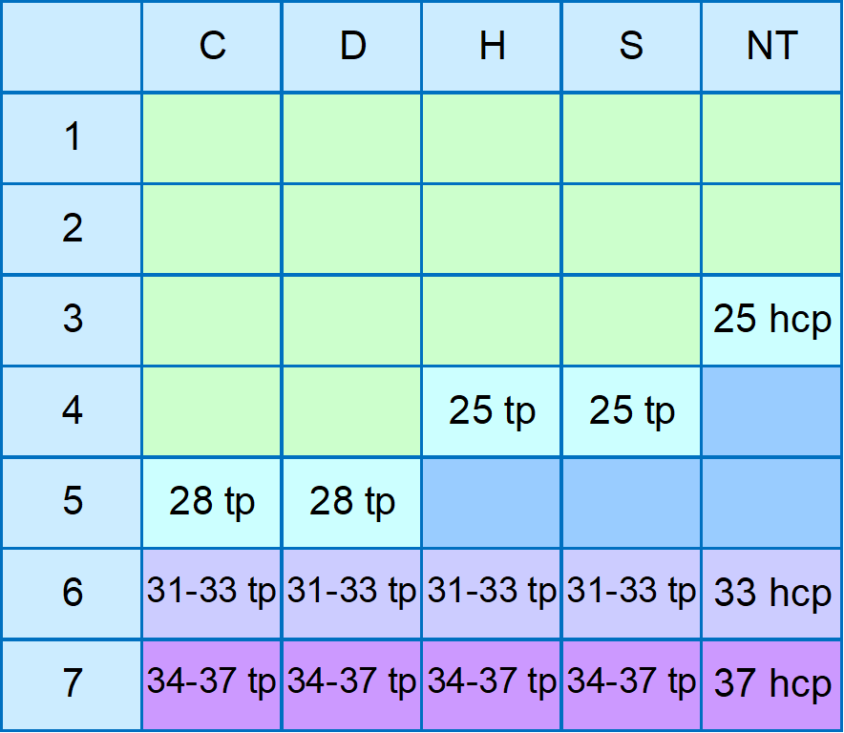
MBC Introduction to Bridge – Ch3. Fit then Game: what is Game and why ?
Suit | Pts per trick | Game Contract (>= 100 pts)
No Trumps | 40 for first; 30 for each subsequent | 3 NT
Major suit (H or S) | 30 | 4 S or H
Minor suit (D or C) | 20 | 5 D or C
Scoring
Game
Bidding and making a contract worth 100 points or more (see above)
Scores 300 bonus points if not vulnerable and 500 bonus points if vulnerable
Your team generally needs a certain number of points to make game
Concepts: Game. Asides: vulnerability (0NEB). Game force
Notes:
What is vulnerability ?
Refer BidandMade.xlsx spreadsheet

Slide 34
MBC Introduction to Bridge – Ch3. Fit then Game: opener’s re-evaluation
If there is a fit, opener should also re-evaluate her hand with shortage points to determine her total points:
( a ) | ( b ) | ( c ) | ( d )
♠ 6 5 ♥ A J 7 6 3 ♦ A K 8 2 ♣ 5 3 | ♠ A 6 2 ♥ A Q 9 4 3 2 ♦ A 8 7 4 ♣ | ♠ J 5 3 2 ♥ A K J 8 6 ♦ A 3 ♣ 9 6 | ♠ A 7 2 ♥ K J 9 7 3 ♦ 8 ♣ A K Q 3
You open 1♥ partner bids 2♥ what do you bid now ? (pg 30 3.2)
Partner opens 1♠ what do you respond ? (pg 32 #1)
( a ) | ( b ) | ( c ) | ( d )
♠ A K 8 2 ♥ 2 ♦ Q 8 7 6 3 2 ♣ 9 6 | ♠ 5 3 2 ♥ Q 4 ♦ K J 4 ♣ J 8 7 4 3 | ♠ K J 7 ♥ A J 2 ♦ 10 9 8 5 ♣ K 8 4 | ♠ J 5 3 ♥ 7 3 ♦ A J 10 9 4 ♣ 10 7 4
Concepts:

Slide 35
MBC Introduction to Bridge – Ch3. Bidding: Responder’s 1-lvl Options
The table below outlines Responder’s bidding options at the 1-level. Next week we expand this to talk about bidding at the 2-level
You have a fit with Opener | No fit – balanced | No fit – 4+M
Re-evaluate your hand NOTE: these are bids LIMIT your hand. Bid the correct level. | With no biddable 4+M at the one level and a balanced sort of hand NOTE: these bids LIMIT your hand. Bid the correct level | With a 4+M which you can bid at the 1 level NOTE: these bids do NOT limit hand
0-5 TP: pass 6-9 TP: Raise one level 10-12 TP: invite to game 13+TP: bid game | 0-5 HCP: pass 6-10 HCP: 1NT* 11-12 HCP: 2NT* 13+ HCP: 3NT | 0-5 HCP: pass 6+ HCP: bid 1M*
Concepts:
Notes:
These ranges are different if you are playing 2 over 1: 1NT: 6-11; 2NT: 12.
NOTE: discuss that there are different approaches to bidding a hand with 4D and 4M (ie bid the M first or bid those diamonds)

Slide 36
MBC Introduction to Bridge – Ch3. Bidding: Pty Ltd ?
Bidding | Limited ?
Opener bids 1S, responder bids 2S | Is responder’s hand limited or not ?
Opener bids 1S, responder bids 3S | Is responder’s hand limited or not ?
Opener bids 1NT | Is opener’s hand limited or not ?
Opener bids 1D, responder passes | Is responder’s hand limited or not ?
Opener bids 1H, responder bids 1NT | Is responder’s hand limited or not ?
Opener bids 1H, responder bids 2C | Is responder’s hand limited or not ? (next week we will discuss)
Concepts:

Slide 37
MBC Introduction to Bridge – Ch3. Fit then Game: additional resources
Review
  Bidding game is where the big scores are made. If you think you have a good chance then go for it; if it depends just how good partner is then ask her to decide (invite)
  If there is a fit, responder can include distribution points and can then use a limit bid to provide partner with a limited point range for her hand
  If there is a fit; opener should re-evaluate her hand by including any distribution points
  What about distribution points for longer than promised trump suits ?
Any questions ?
Lets play some hands
Additional Resources
Bidding: Peter Hollands Understanding Bidding https://www.youtube.com/watch?v=sC0_yxN1LGM
Bid and Made http://www.bidandmade.com/bridge_bid_and_play/Bridge_Bid_0012_Distribution_points.php
Points Schmoints – Sartaj Hans https://www.abf.com.au/teaching/speakers/SartajHansPoints_Schmoints.pdf
Declarer play: https://bridgensw.com.au/wp-content/uploads/2024/11/BNSW-Play-Mini-Unit-3-Length-1.pdf
Bidding practice SAYC Bridge: http://www.saycbridge.com/bid/
Concepts:
Notes:
Play hands from BNSW-Beginner-04-1lvl-Opening-Bids

Slide 38
Suit Order (ascending) Clubs Diamonds Hearts Spades No Trumps | Opener To bid needs 12+ HCP major: 5+ suit minor: 3+ suit Opener HCP Ranges 12-15: Minimum Rebid 16-18: (invitational) Jump Rebid 19+: Game | HCP Ace = 4 King = 3 Queen = 2 Jack = 1
Advancer Discussed in week 7; but for now, assume same as responder | Opening Leads Partners bid suit Top of sequence Low from honour Defending Trumps: Singleton Second highest of rubbish Defending NT: your partnerships long suit | Overcaller Discussed in week 7; but for now, assume same as opener
Points required for game: No Trumps 25 HCP Major 25 TP Minor 28 TP | Responder To bid needs 6+ pts Support partner’s M: 3+ suit 0-5: pass; 6-9: raise 1; 10-12: invite; 13+: bid game Bid new suit (1x): 4+ suit Bid 1NT: 6-10 HCP* | Shortage Pts (*with fit*) Doubleton = 1 Singleton = 3 Void = 5 TP = HCP + shortage pts
Notes:
* These ranges are different if you are playing 2 over 1: 1NT: 6-11;

Slide 39
MBC Introduction to Bridge – Ch3. Fit then Game: review
Concept | Comment | Concept | Comment
Distribution points | After fit found pts for shortages | Total Points (TP) | HCP + distribution pts
Game | 3NT; 4M; 5m. Bidding and making game provides a large boost in your score | Limit bid | A bid which tells partner your minimum and maximum point range
Invite | A bid which asks partner to choose whether to bid game or not
Concepts:

Slide 40
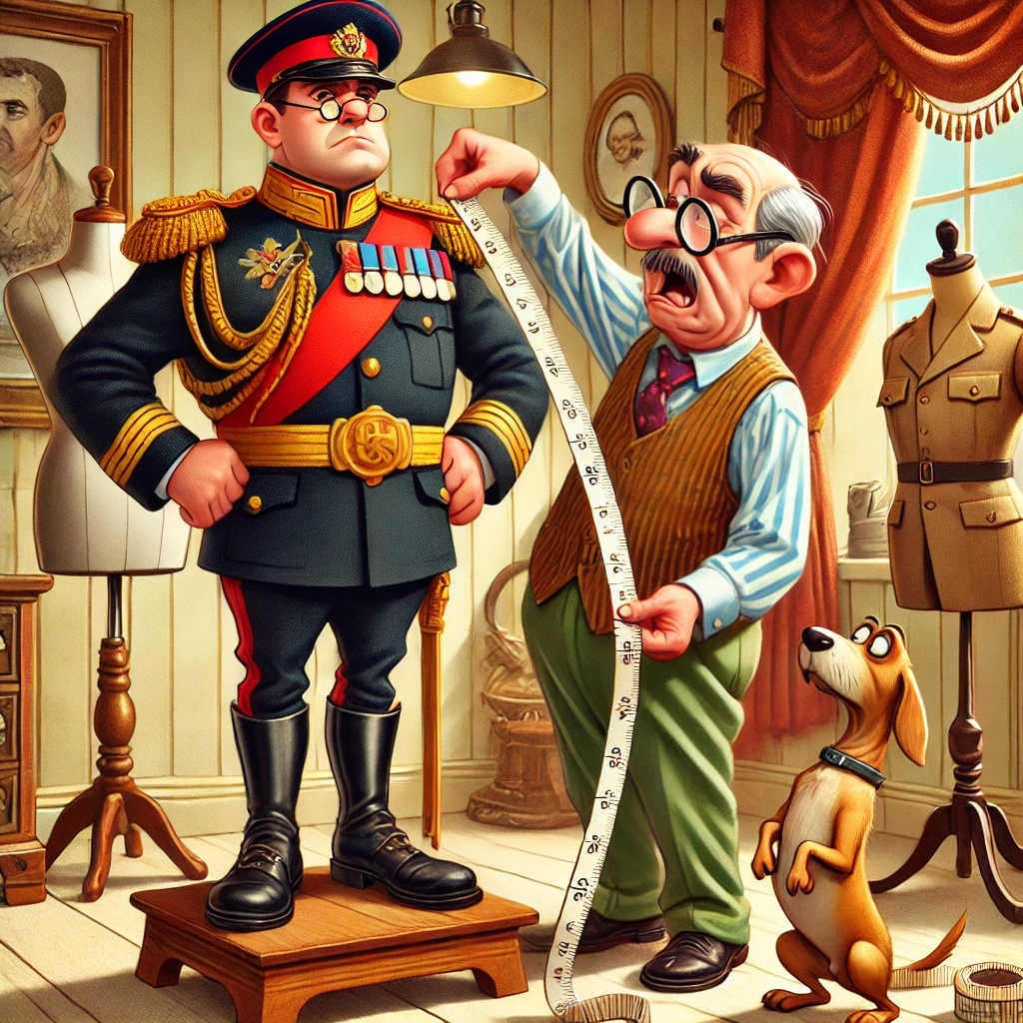
MBC Introduction to Bridge – Ch4. Searching for a major fit: overview
This week we look at Chapter 4 of the book – the major focus is on Opener’s rebid and we take into consideration the strength of opener’s hand. We also review what happens when responder bids a new suit.
We take a brief sidebar into suit shapes – and general concepts in how to bid them
Responder’s priorities when bidding
Opener’s rebids – taking into account opener’s shape
What is a forcing bid
Complexity: High
Importance: Medium
How would you bid these hands. North is Dealer (see #3 not all bids are equal) :
North | South
♠ A J 8 3 ♥ K 5 4 ♦ Q J 9 4 2 ♣ J | ♠ K Q 10 9 ♥ Q J 10 9 8 ♦ A 8 7 ♣ 9
North | South
♠ A J 8 3 ♥ A 5 4 ♦ Q J 9 4 2 ♣ J | ♠ 10 ♥ K Q J 9 8 ♦ A 8 7 4 ♣ 10 9 8
Notes:
Rebid of a suit by responder usually promises six cards – these are pretty solid though ?
NB: need to read the room as to whether we remove some of the slides re hand shapes

Slide 41
MBC Introduction to Bridge – Ch4. wk3 REVIEW – Responder’s LIMIT bids
1. If you have found a fit, responder may include distribution points and use TP for her response
TP range | Bid
0-5 | Pass
6-9 | Raise one level (eg 2♥)
10-12 | Raise two levels (invite eg 3♥) and let partner decide.
13+ | Bid Game (eg 4♥)
# Cards | Term | Pts
2 | Doubleton | 1
1 | Singleton | 3
0 | Void | 5
2. You don’t have the suit, or the points to bid a major, and you have a balanced or semi-balanced hand
HCP range | Bid
0-5 | Pass
6-10* | Bid 1NT
11-12* | Bid 2NT
13+ | Bid Game (3NT)
Note: Once one of our team has made a limit bid (or passed), the other partner may pass at any time.
Notes:
Note: until you have made a limit bid; your hand is unlimited !
What is a balanced hand ? What is a semi-balanced hand ?

Slide 42
MBC Introduction to Bridge – Ch4. Responder bids a new suit
If opener bids a minor; or bids a major which you can’t support ( < 3 of the suit) you should:
HCP | Responder’s Hand | Bid
0-5 | Hmm how best to express this … | Pass
6+ | If you have a 4+M suit biddable at 1 level | Bid 1M
10+* | Unbalanced: if you can’t bid at 1 level you may bid a good new suit at 2 level | 1x or 2x (where x is any new suit). Note 2m shows 4; 2M should be 5+. (see prev slide for Responder’s NT bids)
Opener should note that any new suit by responder (ex 1NT) does NOT limit responder’s hand. These bids are referred to as FORCING. Opener MUST make another bid. NOTE that unlike 2over1, bidding a new suit at the 2-level is not game forcing
( a ) | ( b ) | ( c ) | ( d )
♠ 8 3 ♥ K 5 4 ♦ Q J 4 2 ♣ J 9 8 5 | ♠ 2 ♥ Q J 8 7 2 ♦ A 8 7 2 ♣ J 10 2 | ♠ 8 4 ♥ A Q 10 2 ♦ Q 8 6 ♣ K Q 4 3 | ♠ 8 2 ♥ A K J 10 5 ♦ 8 7 ♣ A K 8 3
Partner opens 1♠ - what do you respond with these hands ?
(pg 47. 4.3)
Concepts: Forcing Bid; Game Force
Notes:
This revision of the book incorporates some aspects of the 2 over 1 bidding system
Note that game force is OFF if there is interference
Game force is also off if responder is a passed hand
Check out https://www.bridgebum.com/two_over_one_off.php
1NT over a major opening doesn’t promise a balanced hand (may be short in the major bid). 1NT is a LIMIT RAISE – and thus may be passed.

Slide 43
MBC Introduction to Bridge – Ch4. Responder’s Priorities
If we have a fit with opener’s major – re-evaluate our hand for shortages and bid accordingly
0-5 HCP: pass
Do we have a major suit that we can bid at 1-level (6+HCP; 4+M)? Bid it
Do we have a major suit that we can bid at the 2-level (10+HCP*; 5+M)? Bid it
Unless there is a reason not to, bid No Trumps (6-10 HCP*: 1NT; 11-12 HCP*: 2NT; 13+ HCP: 3NT)
Bid our minor suit either at the 1-level (6+HCP 4+m) or if necessary at the two level (*10+HCP; 4+m)
Just another reminder ☺ If Responder bids a new SUIT; her hand is unlimited, and Opener MUST make a second bid (Why ?).
… unless
RHO overcalls;
We are a minimum hand; and
we don’t really like responder’s bid
- in which case we may pass as Responder will get another bid
Notes:
This revision of the book incorporates some aspects of the 2 over 1 bidding system
Note that game force is OFF if there is interference
Game force is also off if responder is a passed hand
Check out https://www.bridgebum.com/two_over_one_off.php
1NT over a major opening doesn’t promise a balanced hand (may be short in the major bid). 1NT is a LIMIT RAISE – and thus may be passed.

Slide 44
MBC Introduction to Bridge – Ch4. Opener’s 2nd Bid Priorities
If responder has supported our major suit (limiting her hand) – re-evaluate our hand for shortages and bid accordingly
If responder has bid No Trumps (limiting her hand) – calculate our partnerships min and max total HCP, and if there is a good chance for game, we need to keep bidding, otherwise pass. With a balanced hand, we will probably continue bidding no trumps
If responder has passed (ergo probably 0-5 HCP); either pass or rebid with a strong (16+HCP) hand
If responder has bid a new major suit which we can support (ie we have a fit)– re-evaluate our hand for shortages and support partner’s major accordingly
The following slides discuss our options if we can’t support responder’s new suit ☺ -- but just remember, we may not pass in this case.
Notes:
This revision of the book incorporates some aspects of the 2 over 1 bidding system
Note that game force is OFF if there is interference
Game force is also off if responder is a passed hand
Check out https://www.bridgebum.com/two_over_one_off.php
1NT over a major opening doesn’t promise a balanced hand (may be short in the major bid). 1NT is a LIMIT RAISE – and thus may be passed.

Slide 45
MBC Introduction to Bridge – Ch4. Opener has a fit with responder’s major
Strength | Point range
Minimum | 12-15
Invitational | 16-18
Maximum | 19+
Evaluating Opener’s hand. Just as responder can categorise her hand based on a point range, so can opener:
If opener can support responder’s major suit (4+) bid she should:
If responder bid her major at the 2-level (promising 10+ HCP) – Bid Game with 15
Otherwise re-evaluate her total points (TP) including shortage points. Then
With minimum TP values: raise by one
With invitational TP values: jump a level
With maximum TP values: bid game
Concepts: Forcing bid
Notes:
Note: bidding 2 and making 3 makes just as many points as bidding 3 and making 3.
60% of the time you will get between 7 and 13 HCP
As our bidding system matures we will find better ways to bid most of these hands

Slide 46
MBC Introduction to Bridge – Ch4. Opener’s bid after responder’s NT
If responder’s first bid is No Trumps, we need to calculate our partnership’s minimum and maximum points and then make a rebid.
If we have a balanced (or semi-balanced hand in the minors):
With a minimum hand we will probably pass, otherwise see the graphic to the left.
Concepts: Forcing bid
Notes:
Note: bidding 2 and making 3 makes just as many points as bidding 3 and making 3.
60% of the time you will get between 7 and 13 HCP
Refer spreadsheet points-responder Bid 1

Slide 47
MBC Introduction to Bridge – Ch4. What is a Balanced Hand
In Chapter 5, we talk in detail about how Opener should bid a Balanced hand, but let’s take a sneak preview now. In this chapter, we are not looking at making an opening bid in no trumps – but if we get to opener’s second bid, and we have still not found a fit with our partner – then with a balanced or some semi-balanced hand we will probably be looking to bid no trumps:
Balanced hands:
No voids
No singletons
No more than one doubleton
Possible shapes:
4333; 4432 and 5332
Balanced hands lend themselves to a second bid in no trumps
Semi-Balanced hands:
No voids
No singletons
Two doubletons
Possible shapes: 5422; 6322
Balanced
♠ K 7 ♥ A J 2 ♦ K Q 7 ♣ A J 7 4 3
Semi-Balanced hands where the long suit or second suit is a minor, we may consider making a second bid in no trumps
Concepts: Forcing Bid
Notes:
NB with a 6-4 two suiter you may elect to rebid your six card suit (definitely if it’s a major) rather than bidding your 4 card suit.
NB: split into two

Slide 48
MBC Introduction to Bridge – Ch4. A major fit?: hand shapes pt1
Unbalanced Hands
fall into three categories:
Single suited hands (unbalanced and exactly one suit with
four or more cards): Eg 6322; 6331; 7321 etc.
Single Suited
♠ 5 ♥ A J 2 ♦ K Q J 8 4 2 ♣ J 5 4
Two Suited
♠ 3 ♥ A 6 2 ♦ A Q J 9 3 ♣ Q 10 3 2
Two Suited Hands (unbalanced and exactly two suits with four or more cards): Eg 5422; 5432; 5521; 64xx; 65xx etc
Your hand shape determines your bidding – in particular your rebid options. As opener:
Balanced hands - No Trump
Unbalanced Single suited – rebid your long suit
Unbalanced Two suited – rebid your second suit
Unbalanced Three suited – a few options depending on partner’s bid (or sometimes opponents)
Three Suited
♠ A J 7 6 ♥ 4 ♦ A 10 4 2 ♣ A 5 3 2
Three Suited Hand: Eg 4441; 5440
Concepts: Forcing Bid
Notes:
NB with a 6-4 two suiter you may elect to rebid your six card suit (definitely if it’s a major) rather than bidding your 4 card suit.
NB: split into two

Slide 49
MBC Introduction to Bridge – Ch4. A major fit?: opener’s rebid
Responder has supported your MAJOR (thus limiting her hand) | Pass if she has bid Game. Otherwise re-evaluate your hand. Calculate your team’s TP range (add responder’s TP range to your TP): If your team’s min. TP >= 25 then bid GAME; If your team’s max. TP >= 25 then bid 3 (invite); else Pass
You have a fit (4+) with responder’s new MAJOR | Re-evaluate your hand: 12-15 TP – if responder bid at the 1-level raise responder’s major by one, otherwise bid game. 16-18 TP – if responder bid at the 1-level raise responder’s major by one, otherwise bid game.. 19+ TP – bid GAME.
Responder has bid a new suit BUT you still haven’t found a fit. | With a single-suited hand, rebid your suit; With a two-suited hand, bid your second suit; With a three-suited hand, if there is still a chance for a major fit, bid that major – otherwise bid No Trumps. With a balanced hand, bid no trumps. Note: with 16+HCP, you might jump a level to show partner your strength.
Responder has bid No Trumps (thus limiting her hand) | If responder bid 1 NT (6-10 HCP): You should pass unless you have more than 15 HCP or a highly distributional hand. If highly distributional - with a single-suited hand, rebid your suit and with a two-suited hand, rebid your second suit. With 16+ HCP, add your HCP to your partner’s range. If min HCP >= 25, bid 3NT, otherwise invite with 2 NT. If responder bid 2 NT (11-12 HCP): You should pass with 12 HCP, and bid 3NT with 13+ HCP.

Slide 50
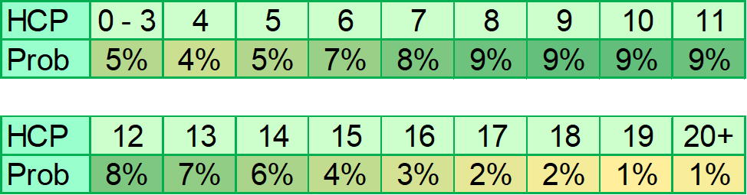
MBC Introduction to Bridge – Ch4. What are the Odds ?

Slide 51
MBC Introduction to Bridge – Ch4. A major fit?: quizzes
Partner opens 1♣ and you respond 1♥. Partner rebids 1♠. Describe her hand
Partner opens 1♦ and you respond 1♥. Partner rebids 1NT. Describe her hand
Partner opens 1♦ and you respond 1♥. Partner rebids 2♣ . Describe her hand
Partner opens 1♦ and you respond 1♠. Partner rebids 1NT. Describe her hand
Partner opens 1♠ and you respond 1NT. Partner rebids 3♦. Describe her hand
Partner opens 1 ♥ and you respond 1♠. Partner rebids 3♥. Describe her hand
Concepts:

Slide 52
MBC Introduction to Bridge – Ch4. A major fit?: quizzes
You open 1♦ and partner responds 1♠. What do you bid now ?
(pg 43. 4.1)
( a ) | ( b ) | ( c ) | ( d )
♠ A 9 7 ♥ A 8 2 ♦ K J 7 6 ♣ J 6 5 | ♠ 3 ♥ A 6 2 ♦ A Q J 9 3 ♣ Q 10 3 2 | ♠ 5 ♥ A J 2 ♦ K Q J 8 4 2 ♣ J 5 4 | ♠ A J 7 6 ♥ 4 3 ♦ A 10 4 2 ♣ A 5 2
( a ) | ( b ) | ( c ) | ( d )
♠ 8 5 4 2 ♥ Q 9 8 6 ♦ K J 3 ♣ J 9 | ♠ A Q 3 ♥ Q J 7 2 ♦ 8 7 2 ♣ K J 2 | ♠ 8 2 ♥ K Q J 10 8 3 ♦ 10 9 ♣ 9 8 5 | ♠ A J 10 ♥ K J 10 5 ♦ 8 6 ♣ A 6 4 2
Partner opens 1♦ and you respond 1♥. Partner rebids 2♣ - what do you bid now ? (pg 44. 4.2)
Partner opens 1♠ - what do you respond with these hands ?
(pg 47. 4.3)
( a ) | ( b ) | ( c ) | ( d )
♠ 8 3 ♥ K 5 4 ♦ Q J 4 2 ♣ J 9 8 5 | ♠ 2 ♥ Q J 8 7 2 ♦ A 8 7 2 ♣ J 10 2 | ♠ 8 4 ♥ A Q 10 2 ♦ Q 8 6 ♣ K Q 4 3 | ♠ 8 2 ♥ A K J 10 5 ♦ 8 7 ♣ A K 8 3
Concepts:

Slide 53
MBC Introduction to Bridge – Ch4. A major fit?: quizzes
Partner opens 1♦ what do you respond ?
(pg 48. #1)
( a ) | ( b ) | ( c ) | ( d )
♠ J 7 6 3 ♥ K 4 ♦ Q 9 8 2 ♣ 9 8 5 | ♠ A Q 4 2 ♥ K Q 10 5 4 ♦ 8 7 ♣ 3 2 | ♠ A 8 2 ♥ 7 2 ♦ 8 4 ♣ A K J 9 4 3 | ♠ K Q 9 8 2 ♥ A K J 10 ♦ J 5 3 ♣ 3
( a ) | ( b ) | ( c ) | ( d )
♠ 7 6 ♥ A K Q 10 6 ♦ Q 9 2 ♣ Q 7 6 | ♠ A Q 2 ♥ A Q 9 7 2 ♦ A 9 8 ♣ K 8 | ♠ A 7 2 ♥ K Q J 9 6 2 ♦ Q 6 5 ♣ 7 | ♠ 3 ♥ A J 9 7 2 ♦ A Q J 7 6 ♣ 9 2
You open 1♥. Partner responds 1NT - what do you bid now ? (pg 48. #3)
NB Bridge bidding standards change quickly – where once people wouldn’t open with less than 13 points, now people are opening with 12 or increasingly with 11. When you use other resources, just be aware that the point ranges may differ to those recommended here.
Additional Resources
Defence: https://www.advinbridge.com/this-week-in-bridge/450
Declarer: https://www.bridgebears.com/bridge-card-game/declarerplay/count-winners.html.
Bidding: https://www.abf.com.au/teaching/speakers/SartajHansPoints_Schmoints.pdf
Declarer: https://bridgensw.com.au/wp-content/uploads/2024/11/BNSW-Play-Mini-Unit-7-Ruffing-in-the-Short-Hand-1.pdf
Bidding (opener’s rebids): https://kwbridge.com/rebids2.htm
Concepts:
Notes:
NOTE: as a defender, if you know what the declarer wants to do, you can try to make her do the opposite. For example, she will usually prefer to ruff in the short hand – so making her ruff in the long hand is a good strategy.

Slide 54
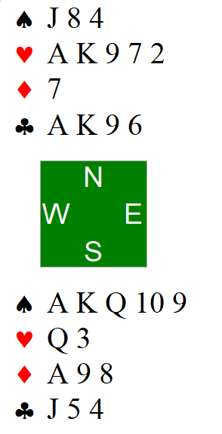
MBC Introduction to Bridge – Play of the Cards. Trumps pt 4
Make a plan.
If one of your hands holds more of a particular suit – this is referred to as the long hand. Unsurprisingly the other hand is referred to as the short hand.
You are in 4S. On the lead of the KD by west, how many trump tricks can you win with this hand ? For our purposes, assume a 5-0 split in trumps
When you eventually come to play your hearts, which hand should win the first trick, and why ?
Notes:
Ruffing in the short hand
Honours from the short hand first

Slide 55
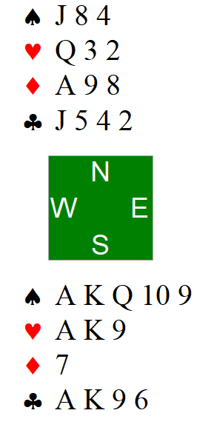
MBC Introduction to Bridge – Play of the Cards. Trumps pt 5
Make a plan.
You are in 4S. On the lead of the KD by west, how many trump tricks can you win with this hand ? For our purposes, assume a 5-0 split in trumps
What if anything has changed ?
Notes:
Ruffing in the short hand
Honours from the short hand first

Slide 56
Suit Order Clubs Diamonds Hearts Spades No Trumps | Opener To bid needs 12+ HCP major: 5+ suit minor: 3+ suit Opener HCP Ranges 12-15: Minimum Rebid 16-18: (invitational) Jump Rebid 19+: Game | HCP Ace = 4 King = 3 Queen = 2 Jack = 1
Advancer Discussed in week 7; but for now, assume same as responder | Opening Leads Partners bid suit Top of sequence Low from honour Defending Trumps: Singleton Second highest of rubbish Defending NT: your partnerships long suit | Overcaller Discussed in week 7; but for now, assume same as opener
Points required for game: No Trumps 25 HCP Major 25 TP Minor 28 TP | Responder To bid needs 6+ pts Support partner’s M: 3+ suit 6-9: support; 10-12: invite; 13+: game Bid new suit (1x): 4+ suit Bid 1NT: 6-10 HCP* To bid a new suit at 2 level: Need 10+ HCP* (and 5+ suit for a major) | Shortage Pts (*with fit*) Doubleton = 1 Singleton = 3 Void = 5 TP = HCP + shortage pts
Notes:
* These ranges are different if you are not playing 2 over 1:
1NT: 6-10;
Need 10+ to bid new suit at the 2 level

Slide 57

MBC Introduction to Bridge – Ch4. A major fit?: review
Concept | Comment | Concept | Comment
Balanced Hand | No void, no singleton, max of one doubleton | Unbalanced Hand | Everything else ☺
One suited hand | One 6+ suit all rest 3 or less | Two suited hand | Unbalanced with two suits 4 or more in length
Three suited hand | Unbalanced with three suits of 4 or more: 4 4 4 1 | Forcing | A bid which forces partner to bid. Note that if there is an intervening bid by opponents, partner may then pass (< 8 pts).
Bid low while you are looking for a fit |  | Game force | Neither partner may pass till a game contract is reached.
Concepts:
Notes:
Play lesson 4 hands from the book
Can also use NSWBA-06 Responders new suit bid

Slide 58
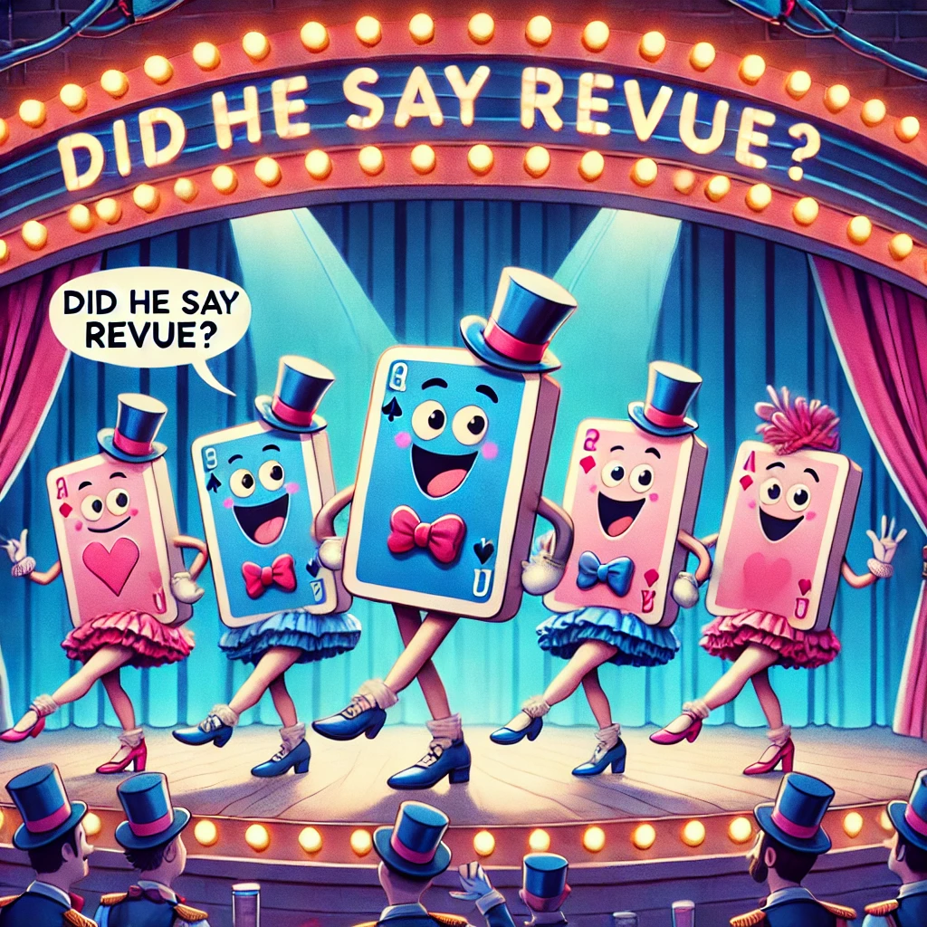
MBC Introduction to Bridge – wk5. Review: weeks 1 - 4
What would you like to review from chapters 1 – 4 ?
Aside: who are your opponents
Aside: a word about shape
Review: not all bids are born equal
How do the best in the world do it ?
Complexity: Low
Importance: Medium
Concepts:
Notes:
Play lesson 1, 2 and 3 hands from the book

Slide 59
MBC Introduction to Bridge – wk5. Review: who are your opponents
Notes:
Rubber bridge vs duplicate bridge
Follow board 1 ☺

Slide 60
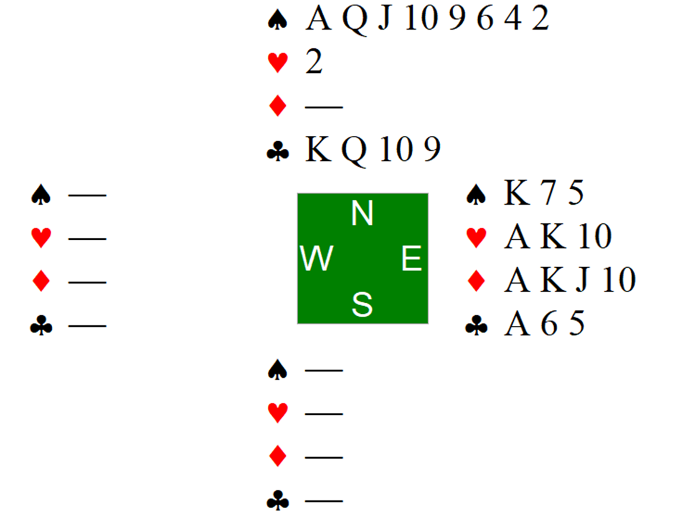
MBC Introduction to Bridge – wk5. Review: A word about shape
Which of these two hands is more likely to make game in something
Notes:
Points schmoints

Slide 61
MBC Introduction to Bridge – wk5. Review: Not all bids …
What a bid of a new suit promises will often vary greatly depending on what your role is when you make the bid – review the following bids for each role:
Bid | By Opener | By Responder | By Overcaller | By Advancer
1♣
1♦
1 ♥
1 ♠
1 NT
Concepts:

Slide 62
MBC Introduction to Bridge – wk5. Review: … are made equal
What a bid of a new suit promises will often vary greatly depending on what your role is when you make the bid – review the following bids for each role:
Bid | By Opener | By Responder | By Overcaller | By Advancer
1♣ | 12+ HCP 3+ ♣ (probably no 5+ M) | ☺ | ☺
1♦ | 12+ HCP 3+ ♦ (probably no 5+ M) | 6+ HCP 4+ ♦ (probably no 4+ M) | 12+ HCP* 5+ ♦
1 ♥ | 12+ HCP 5+ ♥ | 6+ HCP 4+ ♥ | 12+ HCP* 5+ ♥ | See responder
1 ♠ | 12+ HCP 5+ ♠ | 6+ HCP 4+ ♠ | 12+ HCP* 5+ ♠ | See responder
1 NT | 15-17 HCP. Balanced | 6-10* HCP (probably no 4+ M) | 15-17 HCP. Balanced | See responder
Concepts:

Slide 63
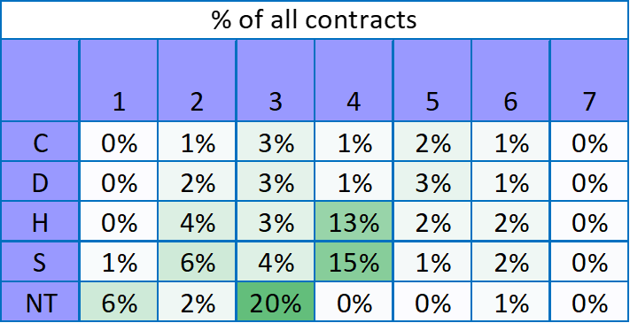
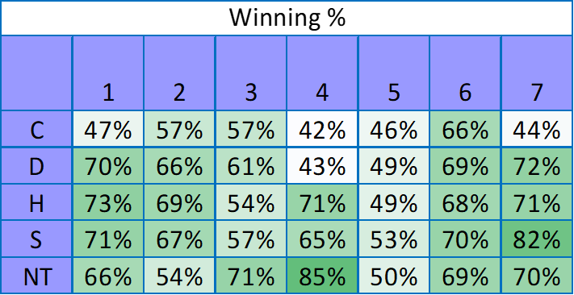
MBC Introduction to Bridge – wk5. Review: should I try for game?
Looking at 65,000 games played at the world bridge championships – 65% of contracts were played at game or above…
… looking at 240 games played at the clubhouse last Monday slightly less than 35% of contracts were game or above. It is common to either not find a fit or not find the points for game.
Concepts:

Slide 64
MBC Introduction to Bridge – wk5. Review: a word or two on defence
Half your games will see you playing defence. The text doesn’t discuss it much; but each game played in defence is like a detective novella – a mini-game of analysis and deduction
Review the bidding. What does it tell you. Where are the points, where are the cards
If you are on lead – what are your partnership preferred first leads ? Nothing obvious ? Then don’t lead their suit, or if you must, lead dummies second suit
Review the first lead. What is your partner telling you ?
Think about your discards – what are you telling your partner:
  When following suit on partners lead, low = encourage; high = discourage
  First discard on any person’s lead, low = encourage; high = discourage
Watch the cards. What is your partner telling you
Watch the cards. What is declarer NOT playing. Why ?
Second player generally plays low
Third player, If partner leads low, generally plays high (what if you have J; K and Dummy has Q still on the table?)
Practice counting, start with just one suit (trumps if it is trump contract) and try to keep adding an extra suit. As soon as one player other than dummy shows out, you can know the count
When counting, I try to count down from the number of cards that are missing (ie I add my count to dummy’s count and subtract that from 13) .. Then I count down each time a card is played from that suit.
When dummy is visible, use dummies cards to help you decide what to lead. If dummy will play 4th, lead to her weakest suit. If dummy is playing 2nd, lead through her strong suits
Concepts:

Slide 65
MBC Introduction to Bridge – Defender: Lead THROUGH strength
North
♠ A Q J 9 7 ♥ K J 7 ♦ ♣ 10 8 7 4
You are West defending against 4 ♥ by South. You won the first trick with your A♦ What do you play now
West
♠ 10 6 5 4 ♥ 10 8 ♦ K 9 8 ♣ A 5 3
East
South
Concepts: Transfers.

Slide 66
MBC Introduction to Bridge – Defender: Lead TO weakness
North
You are West defending against 4 ♥ by South. You won the first trick with your A♦ What do you play now
West
♠ 10 6 5 4 ♥ 10 8 ♦ K 9 8 ♣ K 5 3
East
South
♠ A Q J 9 7 ♥ K J 7 ♦ ♣ 10 8 7 4
Concepts: Transfers.

Slide 67
MBC Introduction to Bridge – Defender: Doubleton
North
You are West defending against 4 ♥ by South. Your partner bid diamonds. Which card do you lead ?
West
♠ 10 6 5 ♥ 10 8 6 4 ♦ 10 8 ♣ K 5 3 2
East
South
Concepts: Transfers.

Slide 68
Suit Order Clubs Diamonds Hearts Spades No Trumps | Opener To bid needs 12+ HCP major: 5+ suit minor: 3+ suit Opener HCP Ranges 12-15: Minimum Rebid 16-18: (invitational) Jump Rebid 19+: Game | HCP Ace = 4 King = 3 Queen = 2 Jack = 1
Advancer To bid needs 6+ pts Support ocall suit: 3+ Bid a new suit: 5+ | Opening Leads Partners bid suit Top of sequence Low from honour Defending Trumps: Singleton Second highest of rubbish Defending NT: your partnerships long suit | Overcaller To bid needs 12+ HCP major: 5+ suit minor: 5+ suit
Points required for game: No Trumps 25 HCP Major 25 TP Minor 28 TP | Responder To bid needs 6+ pts Support partner’s M: 3+ suit 6-9: support; 10-12: invite; 13+: game Bid new suit (1x): 4+ suit Bid 1NT: 6-10 HCP* To bid a new suit at 2 level: Need 10+ HCP* (and 5+ suit for a major) | Shortage Pts (*with fit*) Doubleton = 1 Singleton = 3 Void = 5 TP = HCP + shortage pts
Notes:
* These ranges are different if you are playing 2 over 1:
1NT: 6-11;
Need 12+ to bid new suit at the 2 level

Slide 69

MBC Introduction to Bridge – Ch5. Opener has a balanced hand: overview
This week we look at Chapter 5 of the text - balanced hands:
- how to open them
how to respond
Complexity: Medium
Importance: High
Concepts:
Notes:
Deal cards balanced hands

Slide 70
MBC Introduction to Bridge – Ch5. Balanced hands: opening NT
Opening with a balanced hand (why so many bids ?) :
Balanced hands:
No voids
No singletons
No more than one doubleton
Possible shapes:
4333; 4432 and 5332
HCP | Opening Bid | Rebid
12-14
15-17 | 1NT
18-19
20-21
22+
Concepts:
Notes:
No trump openings (or rebids) are all limiting bids – and so may be passed at any time

Slide 71
MBC Introduction to Bridge – Ch5. Balanced hands: opening NT
Opening with a balanced hand (why so many bids ?) :
Balanced hands:
No voids
No singletons
No more than one doubleton
Possible shapes:
4333; 4432 and 5332
HCP | Opening Bid | Rebid
12-14
15-17 | 1NT
18-19
20-21 | Week 8
22+ | Week 8
( a ) | ( b ) | ( c ) | ( d )
♠ K 7 6 4 2 ♥ A J 2 ♦ K Q 7 ♣ A 7 | ♠ 8 7 6 ♥ A K Q ♦ J 9 8 ♣ A Q 8 4 | ♠ A 9 ♥ A Q 3 2 ♦ Q 7 ♣ A 9 6 5 4 | ♠ A 8 5 ♥ Q 8 7 ♦ K J 10 3 ♣ A 3 2
What do you open with these hands
(pg 55. 5.1)
Any questions ?
Concepts:

Slide 72
MBC Introduction to Bridge – Ch5. Balanced hands: open NT
Opening with a balanced hand (why so many bids ?) :
Balanced hands:
No voids
No singletons
No more than one doubleton
Possible shapes:
4333; 4432 and 5332
HCP | Opening Bid | Rebid
12-14 | Bid your longest suit at the 1 level | 1NT
15-17 | 1NT
18-19 | Bid your longest suit at the 1 level | 2NT
20-21 | Week 8
22+ | Week 8
( a ) | ( b ) | ( c ) | ( d )
♠ K 7 6 4 2 ♥ A J 2 ♦ K Q 7 ♣ A 7 | ♠ 8 7 6 ♥ A K Q ♦ J 9 8 ♣ A Q 8 4 | ♠ A 9 ♥ A Q 3 2 ♦ Q 7 ♣ A 9 6 5 4 | ♠ A 8 5 ♥ Q 8 7 ♦ K J 10 3 ♣ A 3 2
What do you open with these hands
(pg 55. 5.1)
Any questions ?
Concepts:

Slide 73
MBC Introduction to Bridge – Ch5. Balanced hands: responder’s bids
HCP range | Bid
0-7 | Pass
8-9 (invite) | 2NT
10+ | 3NT
 | 7 | 8 | 9 | 10
15 | 22 | 23 | 24 | 25
16 | 23 | 24 | 25 | 26
17 | 24 | 25 | 26 | 27
Responding to opener’s 1NT opening call (15-17 HCP) with a balanced hand:
( a ) | ( b ) | ( c ) | ( d )
♠ J 3 2 ♥ 9 6 3 ♦ A Q 7 2 ♣ 8 5 4 | ♠ 9 7 2 ♥ A K 5 ♦ Q 7 6 3 ♣ 9 5 3 | ♠ K 6 2 ♥ 8 7 ♦ K Q J 8 4 ♣ Q 9 3 | ♠ K J 9 8 7 2 ♥ 2 ♦ K 8 5 ♣ 7 6 2
Partner opens 1NT how do you respond with these hands?
(pg 57. 5.2)
Partner opens 1♣, you bid 1♥ and partner rebids 1NT. What do you bid now?
(pg 60 #3)
( a ) | ( b ) | ( c ) | ( d )
♠ J 4 3 ♥ K 9 3 2 ♦ A Q 7 ♣ 10 6 2 | ♠ Q 10 7 ♥ K Q 4 3 ♦ A K 10 ♣ 9 8 3 | ♠ 5 3 2 ♥ Q J 8 7 6 2 ♦ A 7 2 ♣ 2 | ♠ Q 7 3 ♥ A K 9 7 3 2 ♦ 7 ♣ Q 10 2
Concepts:

Slide 74
MBC Introduction to Bridge – Ch5. Balanced hands: overview
Opener |  | Responder |  | Opener’s Rebid
HCP | Bidding | HCP | Bidding | HCP | Bidding
12-14 | Open 1 of suit (per above). Rebid NT at the lowest level | 0-10 11-12 13+ | First Bid: As usual. Rebid (after opnrs 1NT): Pass Bid 2NT (invitational) => Bid 3NT | 12 13 14 | 1 NT¹ If Invited (ie 2NT response): Pass Bid 3NT Bid 3NT
15-17 | 1NT | 0-7 8-9 10+ | Pass Bid 2NT (invitational) => Bid 3NT | 15 16 17 | If Invited (ie 2 NT response): Pass – stay in 2NT Bid 3NT Bid 3NT
18-19 | Open 1 of suit. Jump rebid NT | 0-5 6+ | First Bid: As usual. Rebid (after opnrs 2NT): Pass Bid 3NT |  | 2 NT
20-21 | 2NT | 0-3 4+ | Pass Bid 3NT
22+ | 2C
¹ Or lowest biddable NT

Slide 75
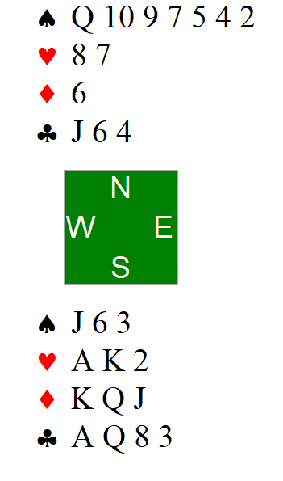
MBC Introduction to Bridge – Play of the Cards. No Trumps pt 2
Make a plan.
Contract is 3NT by South.
West leads the 2C. What is the plan ?
Notes:
Managing entries

Slide 76
MBC Introduction to Bridge – Play of the Cards. No Trumps pt 2
Make a plan.
No Trumps – let’s count our tricks again
So using North’s hand we have:
In spades we can win five tricks (after losing to AK)
In hearts we can win two definite tricks
In diamonds we can win two tricks (after losing to A)
And in clubs we can win two ? definite tricks
If things go our way, we can make ten definite tricks – can you see any potential problems ?
We need to establish those spades as our absolute first priority.
Our plan is: win in south hand with Q; lead JS to low spade; keep winning in south and keep leading spades till AK are both out.
Why lead the JS ?
Where is the KC ?
Notes:
Managing entries

Slide 77
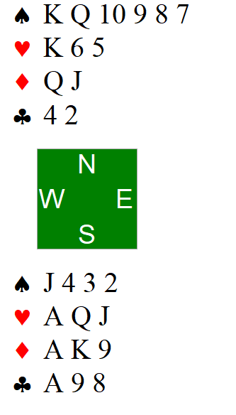
MBC Introduction to Bridge – Play of the Cards. No Trumps pt 3
Make a plan.
Cotract is 3NT by South.
West leads the 5C. What is the plan ?
Concepts: plan.
Notes:
Hold up play

Slide 78
MBC Introduction to Bridge – Play of the Cards. No Trumps pt 3
Make a plan.
No trumps again – count our tricks
So using North’s hand we have:
In spades we can win five tricks (after losing to A)
In hearts we can win three definite tricks
In diamonds we can win three definite tricks
And in clubs we can win one trick
So if things go our way, we can make 12 tricks. What can go wrong ?
West leads the 5C. On any other lead we definitely make 12 tricks. How many clubs are out. How do you think they are likely to split ? East plays the JC. What do you play
Plan = it looks like West may have five clubs and East may have three. So duck the first two rounds of clubs then win with the ace; then play my jack of spades and pray that east has the Ace and not West – because if East has the ace, she cant lead back to West’s two extra club winners
Concepts: plan.
Notes:
Hold up play
If there is only one winnable line – assume that is how the cards lie and play accordingly.

Slide 79
MBC Introduction to Bridge – Ch5. Balanced hands: additional resources
Any questions ?
Lets play some hands
Additional Resources
All About No Trumps by Paul Marston – in library.
No Trump Strategy: https://www.youtube.com/watch?v=Qqfrs3LcWhc
How Not to play No Trumps by Tony Staw: https://www.youtube.com/watch?v=3V5f5eOmbws
https://www.bridgewebs.com/olicana/Declarer%20play%20in%20NT.pdf
http://www.melbournebridge.com.au/Lessons/9_Play_of_the_Hand_in_No_Trump_Contracts.pdf
Concepts:

Slide 80
MBC Introduction to Bridge – Ch5. Balanced hands: review
Concept | Comment | Concept | Comment
Balanced Hand | No void, no singleton, max of one doubleton | 1NT | 15-17 HCP
2NT | 20-21 HCP | With 12-14 or 18-19 Open a suit first then bid NT | 12 – 14 = rebid NT at lowest level 18-19 = jump a level in NT
Concepts:

Slide 81
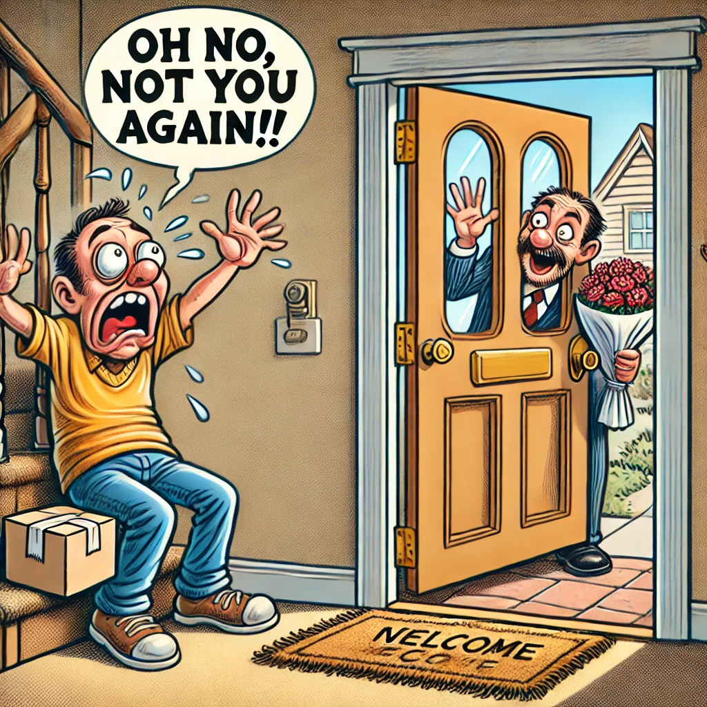
MBC Introduction to Bridge – Ch6. The Overcaller: overview
This week we look at chapter 6 of the book - we talk about the overcaller
They open the bidding but we want to have a say. We can:
Bid our own suit or no trumps;
Make a takeout double;
Pass ☺
Disruption vs bidding a contract
Complexity: Medium
Importance: Medium
Concepts: Double; Takeout Double
Notes:
Remember to overcall in a suit, you MUST have at least five of the suit (even if it is a minor)

Slide 82
MBC Introduction to Bridge – Ch6. the Overcaller: takeout doubles
Takeout Doubles
  - declarer opens and you have opening pts and support for other suits (usually shortage in their bid suit); but no other legal bid (ie no five card suit or insufficient HCP for 1NT)
  - advancer bids her longest suit (she can assume a fit – and thus may include distribution points)
  - in almost all cases, advancer must make a bid (unless opponents make an intervening bid) – if her strongest suit is the opponents’ suit – then 1NT may be the best response
Opponents open 1♦, partner doubles. What do you bid ? (pg 71 6.1)
( a ) | ( b ) | ( c ) | ( d )
♠ 7 3 ♥ J 5 ♦ Q 9 8 6 ♣ Q 7 6 4 3 | ♠ 7 ♥ A Q J 7 6 4 ♦ 7 3 2 ♣ A 8 4 | ♠ J 8 3 2 ♥ 10 3 ♦ Q 8 6 ♣ K 4 3 2 | ♠ A Q 10 7 3 ♥ 6 2 ♦ A J 7 ♣ Q 8 5
Doubler’s rebid
  - when you double, you ask partner to choose the suit and contract. You should NOT rebid unless you have significant values (16+ HCP)
Overcaller can choose between passing, doubling or overcalling
Concepts: Double; Takeout Double
Notes:
There are many different doubles in the game. For our purposes we will only discuss one – the takeout double which can only be made after our opponents have opened the bidding
Indicated by writing an X when it is your turn to bid

Slide 83
MBC Introduction to Bridge – Ch6. the Overcaller: what to bid?
Overcall or double ? Opponent opens 1♥ – what do you do? (pg 73. 6.2)
( a ) | ( b ) | ( c ) | ( d )
♠ A K J 7 3 ♥ 6 2 ♦ A J 6 ♣ 8 6 3 | ♠ A 5 ♥ K Q 8 7 4 ♦ J 8 7 3 ♣ Q J | ♠ A J 8 2 ♥ 7 ♦ J 8 6 4 3 ♣ A Q 3 | ♠ K Q J 10 ♥ 9 6 ♦ K 8 3 ♣ A J 10 8
To overcall opponents opening bid with 1NT, you still need 15-17 HCP, but you also need a stopper in the opponents bid suit(s)
  - a stopper is an honour card with enough support cards that it can stop the opponents run of the suit (minimal stoppers: Ax; Kxx; Qxx; Jxxx
( a ) | ( b ) | ( c ) | ( d )
♠ K Q 7 4 2 ♥ K 9 8 ♦ 7 3 ♣ A 8 5 | ♠ A J 9 5 ♥ A 8 3 ♦ 8 6 ♣ A 8 5 3 | ♠ A J 2 ♥ K Q J 10 5 ♦ 10 8 4 2 ♣ 4 | ♠ J 7 6 ♥ K Q 2 ♦ A J 10 ♣ K Q 6 3
The player on your right opens 1♦ – what do you do? (pg 77. #1)
Concepts: stopper

Slide 84
MBC Introduction to Bridge – Ch6. the Advancer: what to bid?
( a ) | ( b ) | ( c ) | ( d )
♠ 9 7 3 ♥ Q 7 3 2 ♦ K J 3 2 ♣ 6 3 | ♠ 9 7 3 ♥ 6 2 ♦ Q J 7 3 2 ♣ 8 7 2 | ♠ 9 7 3 ♥ A Q J 5 3 ♦ 2 ♣ K 10 5 3 | ♠ J 2 ♥ 6 4 ♦ Q 10 7 6 3 ♣ K Q 6 3
On your left, 1♠, partner doubles, pass on your right. What do you bid?
(pg 77. #2)
On your left, 1♥, partner doubles, pass on your right. What do you bid?
(pg 77. #3)
( a ) | ( b ) | ( c ) | ( d )
♠ A 8 2 ♥ 7 5 ♦ J 7 4 ♣ 9 8 5 4 2 | ♠ Q 8 6 2 ♥ 5 3 ♦ K Q 6 3 ♣ 10 7 3 | ♠ 7 4 ♥ A J 10 7 ♦ K 5 2 ♣ 9 8 6 2 | ♠ A K J 4 2 ♥ 8 3 2 ♦ K 10 9 3 ♣ 9
Concepts:

Slide 85
MBC Introduction to Bridge – Ch6. The Overcaller: additional resources
Any questions ?
Lets play some hands
Additional Resources
Very good info about takeout doubles: https://www.bridgebears.com/bridge-card-game/bidding/doubles.html
Oasis Bridge – takeout double: https://www.youtube.com/watch?v=GvNzaV6x_x4
Oasis Bridge – response to t/o double: https://www.youtube.com/watch?v=HsJbaJTqdmw
NZ Bridge – Finesse: https://www.nzbridge.co.nz/user/inline/1760/NZB%20Beginner%2005%20-%20Tips.pdf
Concepts:

Slide 86
Suit Order (ascending) Clubs Diamonds Hearts Spades No Trumps | Opener To bid needs 12+ HCP major: 5+ suit minor: 3+ suit Opener HCP Ranges 12-15: Minimum Rebid 16-18: (invitational) Jump Rebid 19+: Game | HCP Ace = 4 King = 3 Queen = 2 Jack = 1
Advancer To bid needs 6+ pts Support ocall suit: 3+ Bid a new suit: 5+ | Opening Leads Partners bid suit Top of sequence Low from honour Defending Trumps: Singleton Second highest of rubbish Defending NT: your partnerships long suit | Overcaller To bid needs 12+ HCP major: 5+ suit minor: 5+ suit Double: Promises length in unbid suits
Points required for game: No Trumps 25 HCP Major 25 TP Minor 28 TP Points for slam: Small 33 HCP Grand 37 HCP | Responder To bid needs 6+ pts Support partner’s M: 3+ suit Bid new suit (1x): 4+ suit Bid 1NT: 6-11 HCP* To bid a new suit at 2 level: Need 12+ HCP* (and 5+ suit for a major) | Shortage Pts (*with fit*) Doubleton = 1 Singleton = 3 Void = 5 TP = HCP + shortage pts
Notes:
* These ranges are different if you are not playing 2 over 1:
1NT: 6-10;
Need 10+ to bid new suit at the 2 level

Slide 87
MBC Introduction to Bridge – Ch6. The overcaller: review
Concept | Comment
Takeout Doubles | You should be able to support whatever suit partner bids; to rebid after a takeout double you need 16+ HCP
Advancer (overcaller’s partner) | Firstly calculate your TOTAL POINTS, as you can assume a fit in whatever you bid. If there is no intervening bid, you should make a bid; even if you have ZERO points !! You will bid your longest suit which hasn’t been bid by your opponents. If you have 8+ HCP, a balanced hand and cover in your opponents’ suit(s) you could consider bidding 1NT. If there IS an intervening bid, you may pass *BUT* if you have 8+ points you could bid at the one level, and with 10+ points you could bid at the two level.
Advancer | If you have 13+ TP, you should consider bidding directly to game in a major, or 4 of a minor
Concepts:

Slide 88
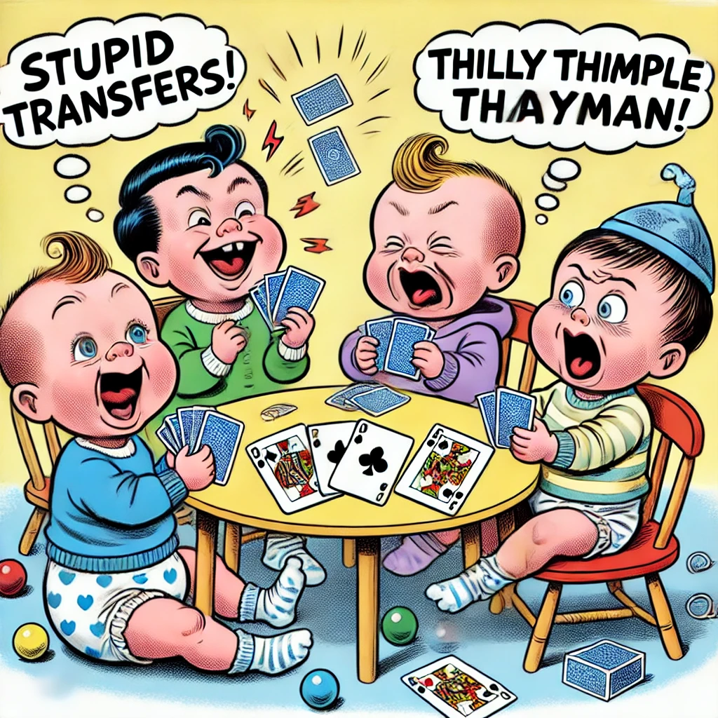
MBC Introduction to Bridge – Ch7. Terrible twos and more: overview
This week we look at the Appendix of the book – and broaden our bidding system further
- Opening 2 bids
- Advanced responses to a no trump opening by partner
Artificial bids
Complexity: High
Importance: Low
Concepts:
Notes:
Read the room. Do a review lesson instead ?

Slide 89
MBC Introduction to Bridge – Ch7. No trumps transfers
If partner opens with a No Trump and you have a 5+ card major, you should use a special artificial bid called a transfer to tell your partner about your long major. In short, you will bid the suit one BELOW your major. So with 5+ hearts, bid diamonds and with 5+ spades bid hearts. Partner then bids your suit.
The reason to do this is so that the strong hand (the no trump hand) remains hidden from your opponents.
NB: the LESS points you have the more important to transfer
NBB: you may only bid a transfer bid if RHO passes. (system is OFF after interference).
Op. | Resp. |  | Op. | Resp.
1 NT | 2♦ 2♥ | 5+♥; 0+ HCP 5+♠; 0+ HCP | 2♥ 2♠ | 0-7 HCP: pass 8-9 HCP: 2NT 10+ HCP: 3NT
2 NT | 3♦ 3♥ | 5+♥; 0+ HCP 5+♠; 0+ HCP | 3♥ 3♠ | 0-3 HCP: pass 4 HCP: invite 5+ HCP: 3NT
How would you bid these hands (North is opener) …
North | South
♠ A J 8 ♥ K Q ♦ Q J 9 4 2 ♣ Q J 9 | ♠ K Q 10 ♥ Q J 10 9 8 ♦ A 8 7 ♣ 6
North | South
♠ A J 8 ♥ K Q ♦ Q J 9 4 2 ♣ Q J 9 | ♠ 10 9 7 6 5 ♥ J 10 9 8 ♦ 8 7 5 ♣ 8
North | South
♠ A K Q 8 ♥ K Q 7 ♦ K Q J 4 ♣ J 9 | ♠ 10 4 2 ♥ J 10 9 8 5 ♦ 8 7 2 ♣ K 9
Concepts: Transfers.

Slide 90
MBC Introduction to Bridge – Ch7. No trumps simple stayman
If partner opens a No Trump and you have
8+ HCP (for 1 NT; 4+ HCP for 2NT opening)
A 4 card heart suit and/or a 4 card spade suit;
Some shape in your hand (ie don’t use stayman if you are 4333)
You can explore for a major suit fit by using Stayman
NOTE: you may only bid Stayman if RHO passes. (system is OFF after interference).
Open | Responder |  | Opener’s Rebid
1 NT | 2♣ | 8+HCP; 4♥ and/or 4♠ | 2♦ 2♥ 2♠ | Denies 4 card major 4+♥. May still have 4♠ 4+♠
2 NT | 3♣ | 4+HCP; 4♥ and/or 4♠ | 3♦ 3♥ 3♠ | Denies 4 card major 4+♥. May still have 4♠ 4+♠
How would you bid these hands (North is opener) …
North | South
♠ A J 8 ♥ K Q 7 ♦ Q J 9 4 ♣ Q J 9 | ♠ K Q 10 ♥ J 10 9 8 ♦ A 8 7 4 ♣ 6 3
North | South
♠ A J 8 ♥ K Q 7 ♦ Q J 9 4 ♣ Q J 9 | ♠ K Q 10 ♥ J 10 9 8 ♦ A 8 7 ♣ 6 3 2
North | South
♠ A J 8 4 ♥ K Q 7 4 ♦ Q J 9 ♣ K J 9 | ♠ K Q 10 ♥ J 10 9 8 ♦ A 8 7 6 ♣ 6 2
North | South
♠ A K Q 8 ♥ K Q 7 ♦ K Q J 4 ♣ J 9 | ♠ K 10 3 ♥ J 10 9 8 ♦ 9 8 7 6 5 ♣ 6
Concepts: Simple Stayman.

Slide 91
MBC Introduction to Bridge – Ch7. Strong 2 openings
There are two bids reserved for opener when she has a really strong hand with lots of points:
2NT shows 20-21 HCP and a balanced hand
2♣ shows 20+ HCP. Note if you have a balanced hand and 22+ points, bid 2♣ and then rebid No Trumps. An opening 2♣ is an example of an artificial bid.
2♣ is game forcing
Responses to 2NT
Responses to 2♣
Response | Promises
Pass | 0-3 HCP
3♦ | Transfer to ♥
2♥ | Transfer to ♠
3♣ | Stayman
3 NT | 4-11 HCP; Denies 4+ M
Response | Promises
2♦ | 0-7 HCP (artificial bid)
2♥ | 8+ HCP; 5+ ♥
2♠ | 8+ HCP; 5+ ♠
2NT | 8+ HCP; balanced.
3♣ | 8+ HCP; 5+ ♣
3♦ | 8+ HCP; 5+ ♦
Opener’s Rebid
- Transfers and stayman are discussed later in this chapter
Opener’s Rebid
- With a balanced hand and 22-23 pts bid No Trumps; otherwise bid suit
Concepts: Opening 2C and 2NT; artificial bids.

Slide 92
MBC Introduction to Bridge – Ch7. Weak 2 openings
Response | Promises
2♦ | 6-10 HCP; 6+ ♦
2♥ | 6-10 HCP; 6+ ♥
2♠ | 6-10 HCP; 6+ ♠
The three remaining two level openings all show a weak hand with a long suit:
Initially you may want to have at least two honours in the weak suit; but more commonly nowadays that is not expected. If you are vulnerable – you should err on the high side of the HCP range (eg 9 or 10 HCP).
Any questions ? Lets play some cards ☺
Additional Resources
Karen’s Bridge: https://kwbridge.com/weak2.htm
Oasis Bridge – Weak Two opening bids: https://www.youtube.com/watch?v=4G4P2wicryg
Bridget Rampton– 2 club opening: https://www.youtube.com/watch?v=oho_3d5_L5I (volume is a bit low)
Peter Hollands – how to play Stayman: https://www.youtube.com/watch?v=oho_3d5_L5I
Peter Hollands – Learn to play Transfers: https://www.youtube.com/watch?v=C4YdTpepLdw
Concepts: Weak twos

Slide 93
MBC Introduction to Bridge – Ch7. Advanced bidding: review
Concept | Comment
Transfers | After partner opens a no trump, if you have a 5+ card major – bid the suit below for opener to accept the transfer by bidding your suit. System is OFF after interference (excluding a double)
Stayman | After partner opens a no trump, if you have a four card major and enough points(8+ if responding to 1NT; 4+ if responding to 2NT) bid 2♣ asking partner if she has a four card major. System is OFF after interference (excluding a double)
Strong Twos | With 20+ HCP bid: 2NT with 20-21 and a balanced hand 2♣ otherwise.
Weak Twos | The remaining three two-level opening bids all show a weak hand (6-10 HCP) and a long suit (6+)
Concepts:

Slide 94
MBC Introduction to Bridge – About
This document created on behalf of the Mollymook Bridge Club based on Paul Marston’s Introduction to Bridge
A copy of this document (PPT), hand records for each lesson and a first draft bidding reference sheet are all available from this google drive: https://docs.google.com/presentation/d/14wY8lJJRN_wuUGYTN3N1sVjAcc53TBXu/edit?usp=drive_link&ouid=111006996788244744891&rtpof=true&sd=true
# | Who | When | What
1.12 | JR | Apr 2024 | Minor updates. Used this version to generate a printable PDF
1.13 | JR | Apr 2024 | Updated review commentary for lesson 8.
1.14 | JR | Apr 2024 | Minor update to lesson 5 (opener’s rebids)
2.00 | JR | Jan 2025 | Revised and rewritten for Intro to Bridge Version 6: 2 over 1
2.01 | JR/LR | Feb 2025 | Added chapter graphics
2.02 | RD/ND | Feb 2025 | Included updates/corrections from Rae and Neil Duffy
2.03 | JR | Mar 2025 | P28. Advancer bids
2.04 | JR | Jun 2025 | Updated to focus more on player roles, rather than follow text exactly. So chapter 2 focus is opener role but includes basic responder bid; chapter 3 focus is responder role and her first bid options; and chapter 4 focus is opener role and her rebids. Moved chapter 4 (review) to after the next chapter.
2.05 | JR | Jun 2025 | Added presenter notes
2.06 | JR | Aug 2025 | Reverted to Standard rather than 2 over 1. Included more references to card play from NSWBA and BNZ.

Slide 95
MBC Introduction to Bridge – Declarer: Preserve your Entries
North
♠ A Q J 10 8 7 ♥ 7 5 ♦ 9 4 2 ♣ K 9
You are South, in 3NT. West leads the ♣Q. Plan the play
West
♠ K 6 5 4 ♥ 10 8 6 ♦ 9 4 2 ♣ Q J 9 7 5
East
South
♠ 3 ♥ A 10 9 8 ♦ A 8 7 ♣ A 6
Concepts: Transfers.

Slide 96
MBC Introduction to Bridge – Declarer: Hold Up Play
North
♠ A Q J ♥ K J 7 5 ♦ K 9 4 2 ♣ 10 8
You are South, in 3NT. West leads the ♣5 to East’s ♣K. Plan the play
West
East
South
♠ 3 2 ♥ A 10 9 8 ♦ A 8 7 ♣ A 6 3
Concepts: Transfers.

Slide 97
MBC Introduction to Bridge – Defender: Lead THROUGH strength
North
♠ A Q J 9 7 ♥ K J 7 ♦ ♣ 10 8 7 4
You are West defending against 4 ♥ by South. You won the first trick with your A♦ What do you play now
West
♠ 10 6 5 4 ♥ 10 8 ♦ K 9 8 ♣ A 5 3
East
South
Concepts: Transfers.

Slide 98
MBC Introduction to Bridge – Defender: Lead TO weakness
North
You are West defending against 4 ♥ by South. You won the first trick with your A♦ What do you play now
West
♠ 10 6 5 4 ♥ 10 8 ♦ K 9 8 ♣ K 5 3
East
South
♠ A Q J 9 7 ♥ K J 7 ♦ ♣ 10 8 7 4
Concepts: Transfers.

Slide 99
MBC Introduction to Bridge – Defender: Doubleton
North
You are West defending against 4 ♥ by South. Your partner bid diamonds. Which card do you lead ?
West
♠ 10 6 5 ♥ 10 8 6 4 ♦ 10 8 ♣ K 5 3 2
East
South
Concepts: Transfers.

Slide 100
Suit Order (ascending) Clubs Diamonds Hearts Spades No Trumps | Opener To bid needs 12+ HCP major: 5+ suit minor: 3+ suit Opener HCP Ranges 12-15: Minimum Rebid 16-18: (invitational) Jump Rebid 19+: Game | HCP Ace = 4 King = 3 Queen = 2 Jack = 1
Advancer To bid needs 6+ pts Support ocall suit: 3+ Bid a new suit: 5+ | Opening Leads Partners bid suit Top of sequence Low from honour Defending Trumps: Singleton Second highest of rubbish Defending NT: your partnerships long suit | Overcaller To bid needs 12+ HCP major: 5+ suit minor: 5+ suit Double: Promises length in unbid suits
Points required for game: No Trumps 25 HCP Major 25 TP Minor 28 TP Points for slam: Small 33 HCP Grand 37 HCP | Responder To bid needs 6+ pts Support partner’s M: 3+ suit Bid new suit (1x): 4+ suit Bid 1NT: 6-11 HCP* To bid a new suit at 2 level: Need 12+ HCP* (and 5+ suit for a major) | Shortage Pts (*with fit*) Doubleton = 1 Singleton = 3 Void = 5 TP = HCP + shortage pts
Notes:
* These ranges are different if you are not playing 2 over 1:
1NT: 6-10;
Need 10+ to bid new suit at the 2 level

Slide 101
Responder’s bids with fit
Strength | TP range | Bid
Disappointing :p | 0-5 | Pass
Minimum | 6-10 | Raise one level (eg 2♥)
Invitational | 11-12 | Invite (eg 3♥) and let partner decide.
Maximum | 13+ | Bid Game (eg 4♥)
Strength | Point range
Minimum | 12-15
Invitational | 16-18
Maximum | 19+
Opener’s Hand Strength

Slide 102
Good Points | Bad Points
Most of your Honours in your team’s suit(s) | Honours in opponents’ suits
Royals work better together (! Harry). You want your honours clustered | Honours isolated across all suits
Length in a suit (5+) | Flat hand (eg 4333)
Good pips: 10s, 9s and 8s | Bad pips: 2s, 3s, 4s, 5s etc
Sequences (Q J 10 8) | Broken suits (K 7 5 2)
 | Unsupported honours (eg singleton queen)
Honours in unbid suits are better than .. | Honours in opponents’ suits
Honours in right hand opponents (RHO) suit are better than … | Honours in left hand opponents (LHO) suit

Slide 103
67,000 World Bridge Games – a brief analysis
Opening Leads – Frequency and success rate
Contracts bid and their success rate
Notes:
dbh
doubleton with honour (eg Kx)
dbl
doubleton with pips (eg xx)
dbs
doubleton sequence (eg JT)
hns
3rd/4th/5th highest pip card in a suit headed by an honour sequence (eg 4 from QJ74)
hnx
3rd/4th/5th highest pip card in a suit headed by an honour (eg 5 from A9852). Split to Anx; Knx; Qnx; Jnx; Tnx
hoi
A card (could be pip or honour) from an internal sequence. Not always the top of the internal sequence. (eg J from AJT etc; or 9 from KJT9)
hos
Lead of an honour from an honour sequence (eg K from AK or Q from QJ)
hot
some other honour lead (eg A from A9543)
jnk
lead of a non-honour card from a suit headed by a pip (eg 9 from 973)
olp
lead came from the opening leads partner (lead out of turn) – excluded from analysis
prs
partners bid suit (any lead of a card in a suit BID by opening leads partner – NOTE take out doubles were NOT included … V 1.99 maybe)
sng
singleton
trm
trumps (any lead of the opponents’ final contract suit)
unk
unexpected lead type – generally unexpected LIN data – excluded from analysis

Slide 104
MBC Introduction to Bridge – Play of the Cards. Trumps pt 1
Make a plan.
Contract is 4S by North.
East leads a small club. How do you plan on playing this hand ?
Notes:
If you have clear winners in the off suits – generally play trumps first.

Slide 105
MBC Introduction to Bridge – Play of the Cards. Trumps pt 1
Make a plan.
In a trump contract, you usually start off by counting your losers. Start with the hand with the most trumps; and then go suit by suit, using the cards from both hands for that suit and count how many high cards are missing.
So using North’s hand we have:
No losers in spades (the jack is in souths hand)
One loser in hearts (we are missing the Ace)
One loser in diamonds (we have Akx)
And no losers in clubs (we have AK)
Now count your trumps. How many do the opponents have. How are they likely to split ?
In trumps, if we have enough winners in side suits, it is best to draw trumps first and then play our winners in the side suits (ie we don’t want our opponents to trump in).
Plan = draw trumps; win off suit tricks. (losing one heart and one diamond)
Notes:
If you have clear winners in the off suits – generally play trumps first.

Slide 106
MBC Introduction to Bridge – Play of the Cards. Trumps pt 2
Make a plan.
Contract is 2S by South.
West leads a small club again ☺ how do you plan on playing this hand ?
Notes:
If our hand are strong in the off suits – play trumps first !! Regardless of our trump holding strength

Slide 107
MBC Introduction to Bridge – Play of the Cards. Trumps pt 2
Make a plan.
Trump contract again – count your losers
So using North’s hand we have:
In spades we have three losers (AKQ)
One loser in hearts (we are missing the Ace)
No losers in diamonds (we have AKQ)
And no losers in clubs (we have AK)
Now count your trumps. How many do the opponents have. How are they likely to split ?
Despite those losing trumps; we still have great off suit winners – so get rid of opponents’ trumps (yes, we will lose a few tricks) *before* being tempted to take your off suit winners.
NOTE: though we count three losers in spades, how many do you think we are likely to lose ?
Plan = draw trumps (losing three rounds); then play off suit tricks (losing a further one)
Notes:
If our hand are strong in the off suits – play trumps first !! Regardless of our trump holding strength

Slide 108
MBC Introduction to Bridge – Play of the Cards. Trumps pt 3
Make a plan.
Contract is 4S by North
East leads a small club – what is the plan ?
Notes:
Don’t start playing trumps until you have made a plan – should we look for ruffing opportunities ?

Slide 109
MBC Introduction to Bridge – Play of the Cards. Trumps pt 3
Make a plan.
Trumps again – lets count our losers
So using North’s hand we have:
Three losers in spades (AKQ)
No losers in hearts
Four losers in diamonds
And no losers in clubs (we have AK)
Now count your trumps. How many do the opponents have. How are they likely to split ?
In trumps, if we have a lot of losers in our side suits; we want to find a way to use our trumps to ruff those losers. So now, we *don’t* want to start off by leading trumps, but we want to make our ruffs early.
How are the diamonds likely to split ?
Is there another way to get rid of a losing diamond ?
How will we get back to the north hand ?
Plan = win in North, D ruff, heart to A, D ruff; H to K; D ruff; AC; xC ruff; D ruff. Draw trumps.
Notes:
Don’t start playing trumps until you have made a plan – should we look for ruffing opportunities ?

Slide 110
MBC Introduction to Bridge – Play of the Cards. Trumps pt 4
Make a plan.
If one of your hands holds more of a particular suit – this is referred to as the long hand. Unsurprisingly the other hand is referred to as the short hand.
On the lead of the KD by west, how many trump tricks can you win with this hand ?
When you eventually come to play your hearts, which hand should win the first trick, and why ?
Notes:
Ruffing in the short hand
Honours from the short hand first

Slide 111
MBC Introduction to Bridge – Play of the Cards. Trumps pt 5
Make a plan.
On the lead of the KD by west, how many trump tricks can you win with this hand ?
What if anything has changed ?
Notes:
Ruffing in the short hand
Honours from the short hand first

Slide 112
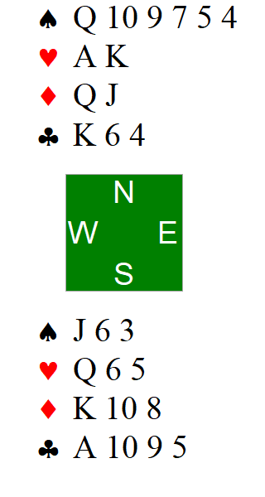
MBC Introduction to Bridge – Play of the Cards. No Trumps pt 1
Make a plan.
Contract is 3NT by North. East leads JH. What is the plan.
Concepts: plan.
Notes:
Counting tricks

Slide 113
MBC Introduction to Bridge – Play of the Cards. No Trumps pt 1
Make a plan.
There are lots of different approaches to counting tricks in no trumps. I am going to propose that we count our tricks after ‘promoting’ where necessary (this is different to counting quick tricks or top tricks)
So using North’s hand we have:
In spades we can win three tricks (after losing to AK)
In hearts we can win three tricks
In diamonds we can win two tricks (after losing to A)
And in clubs we can win two tricks
So if things go our way, we can make 10 tricks. In no trumps, you generally want to establish your long suit first – that is lose any losers you have to, and then the rest of the suit are winners.
Plan = on a heart lead, win in north, play small spade to jack. Keep winning other suits and keep leading spades till we get rid of AK. Next, make at least one Diamond winner (lose your losers early) then take your winners.
NOTE: in those diamonds, play honours from the short hand first
Concepts: plan.
Notes:
Counting tricks

Slide 114
MBC Introduction to Bridge – Play of the Cards. No Trumps pt 2
Make a plan.
Contract is 3NT by South.
West leads the 2C. What is the plan ?
Notes:
Managing entries

Slide 115
MBC Introduction to Bridge – Play of the Cards. No Trumps pt 2
Make a plan.
No Trumps – let’s count our tricks again
So using North’s hand we have:
In spades we can win five tricks (after losing to AK)
In hearts we can win two definite tricks
In diamonds we can win two tricks (after losing to A)
And in clubs we can win two ? definite tricks
If things go our way, we can make ten definite tricks – can you see any potential problems ?
We need to establish those spades as our absolute first priority.
Our plan is: win in south hand with Q; lead JS to low spade; keep winning in south and keep leading spades till AK are both out.
Why lead the JS ?
Where is the KC ?
Notes:
Managing entries

Slide 116
MBC Introduction to Bridge – Play of the Cards. No Trumps pt 3
Make a plan.
Cotract is 3NT by South.
West leads the 5C. What is the plan ?
Concepts: plan.
Notes:
Hold up play

Slide 117
MBC Introduction to Bridge – Play of the Cards. No Trumps pt 3
Make a plan.
No trumps again – count our tricks
So using North’s hand we have:
In spades we can win five tricks (after losing to A)
In hearts we can win three definite tricks
In diamonds we can win three definite tricks
And in clubs we can win one trick
So if things go our way, we can make 12 tricks. What can go wrong ?
West leads the 5C. On any other lead we definitely make 12 tricks. How many clubs are out. How do you think they are likely to split ? East plays the JC. What do you play
Plan = it looks like West may have five clubs and East may have three. So duck the first two rounds of clubs then win with the ace; then play my jack of spades and pray that east has the Ace and not West – because if East has the ace, she cant lead back to West’s two extra club winners
Concepts: plan.
Notes:
Hold up play
If there is only one winnable line – assume that is how the cards lie and play accordingly.

