Slide 1
Conventional wisdom

Slide 2
Agenda
Why do we play conventions?
Four conventions everyone should play
Four more for the eager student
Another four for the more adventurous
And for the real convention junkie…
What to know before you play a convention

Slide 3
Why do we play conventions?
Better communication than with natural bids
Improved decision-making
To gain a strategic advantage in specific situations

Slide 4

Four conventions everyone should play
Negative Doubles
Stayman
Transfers
Blackwood

Slide 5
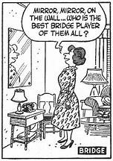
Four more for the eager student
4th Suit Forcing to Game
Defense after Opponents’ 1NT
Weak Jumps in Competition
2NT after Partner’s Weak 2

Slide 6
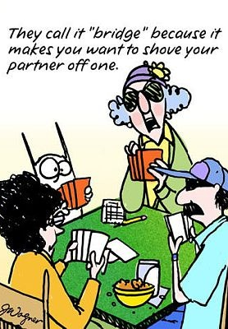
Another Four for the more adventurous
Unusual 2NT/Michaels
New Minor Forcing
Jacoby 2NT
Support Doubles

Slide 7
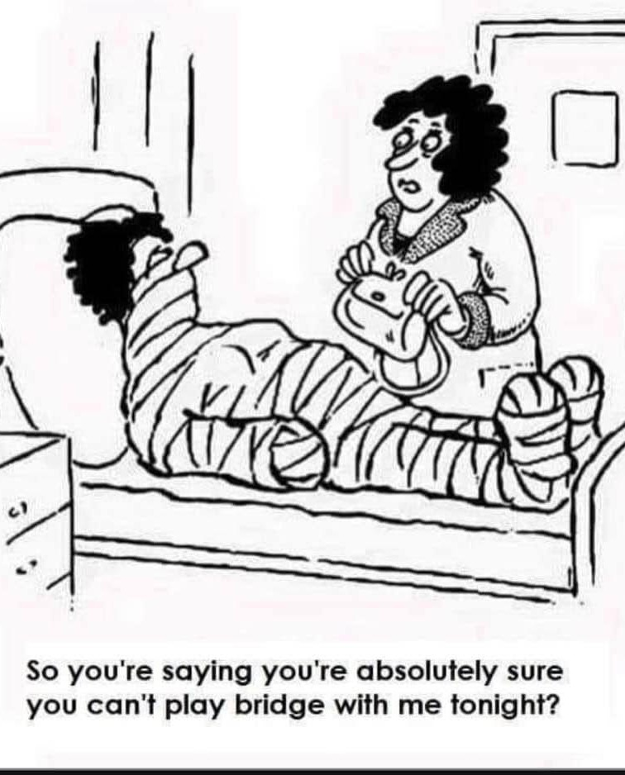
And for the real convention junkie…
Lebensohl
Drury
Inverted Minors
Splinters

Slide 8
What to know before you play a convention
What problem does this convention solve? And more importantly, is this a problem worth solving?
What are you giving up, how important is it, and can you replace it with something else?
How much information are you giving to the opponents and is it necessary?
When does the convention apply?

Slide 9
What to know before you play a convention
What are the responses and rebids?
What does it mean when partner does not use a convention?
What happens if the opponents interfere?
How will you describe the convention if the opponents ask?

