Slide 1
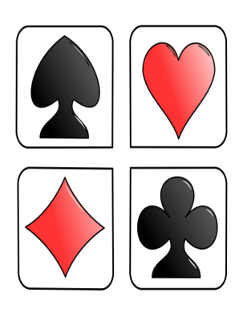
Camberley Bridge Club
Transition Group
If you enjoy playing bridge but aren’t sure what to expect from playing in a club environment, then our new transition group can help you with this.
Over an eight week course, we’ll aim to cover the topics which introduce you to duplicate bridge and how it’s played in bridge clubs. Each session will start with 30 minutes’ tuition followed by a tea break then a gentle duplicate play session.
The sessions will be held in our club venue in Camberley Cricket Club from
2.00 p.m. to 5.00 p.m. on the following Mondays:
The whole course will cost £40 per person and includes membership of Camberley Bridge Club for the remainder of the membership year (September 2019). At the end of the course we’ll enrol you into the EBU.
To ensure that we can provide good support throughout the session, there will be a maximum of 20 participants. Partners aren’t required; if you don’t have a regular partner, we’ll find you one on the day.
To enrol, follow the attached link to our website where you will find a link to register interest:
www.bridgewebs.com/camberley/
You can contact us from there or by calling Penny Moody on 07986 157733
15th April 29th April 13th May June 3rd | June 10th June 17th June 24th July 1st

