Slide 1
PLAY IT AGAIN
A TOOL TO IMPROVE YOUR PLAY

Slide 2
PLAY IT AGAIN
HAVE YOU EVER LOOKED AT THE HAND RECORDS AND WONDERED HOW TO:
MAKE THE MAXIMUM NUMBER OF TRICKS?
HOW TO DEFEND THE HAND PROPERLY?
HOW TO FIND THE KILLING OPENING LEAD?
THIS TUTORIAL SHOWS HOW TO USE THE “RESULTS” FEATURE ON THE WICKHAM PARK BRIDGE PAGE.

Slide 3
PLAY IT AGAIN
NAVIGATE TO http://www.bridgewebs.com/wickhampark/

Slide 4
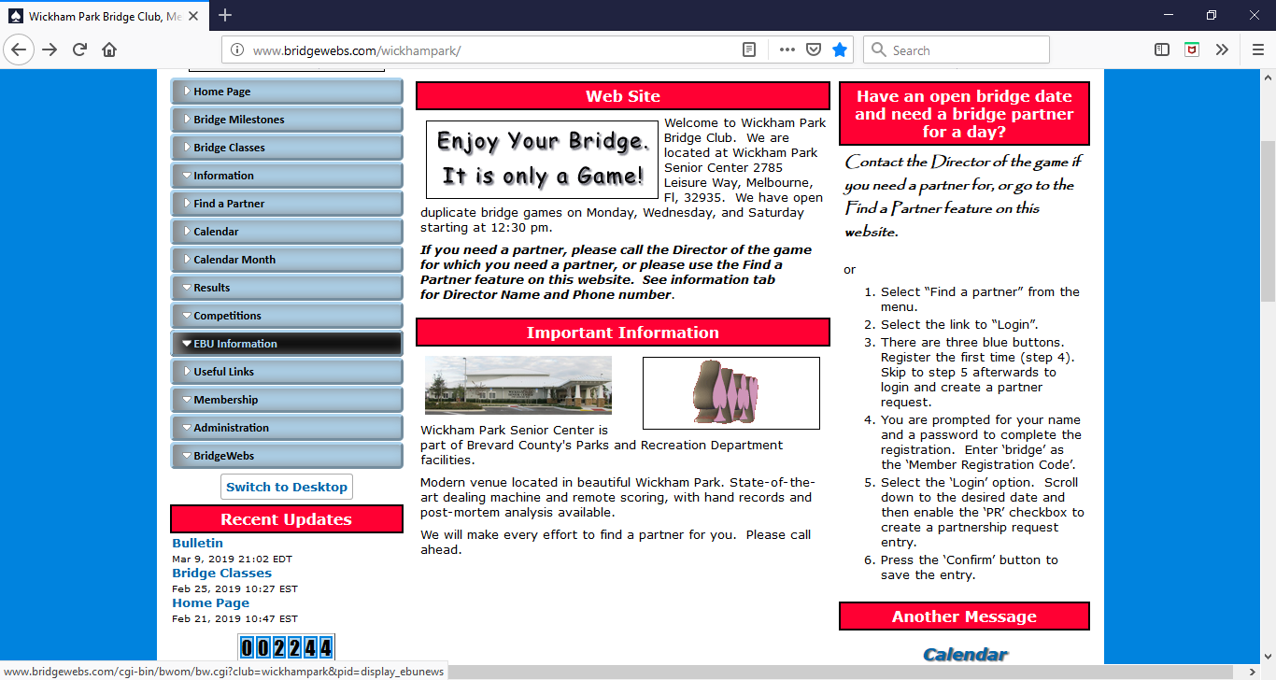

Slide 5
PLAY IT AGAIN
SELECT THE OPTION ENTITLED ‘RESULTS’
SELECT THE LINK FOR THE DESIRED GAME
THE NEXT TWO SLIDES SHOW WHAT APPEARS AFTER YOU SELECT ‘RESULTS’ AND THEN SELECT THE ENTRY FOR MONDAY, MARCH 18.

Slide 6
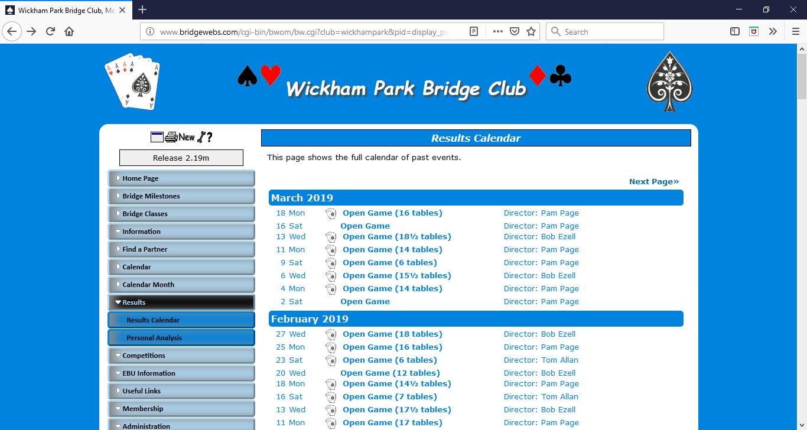

Slide 7
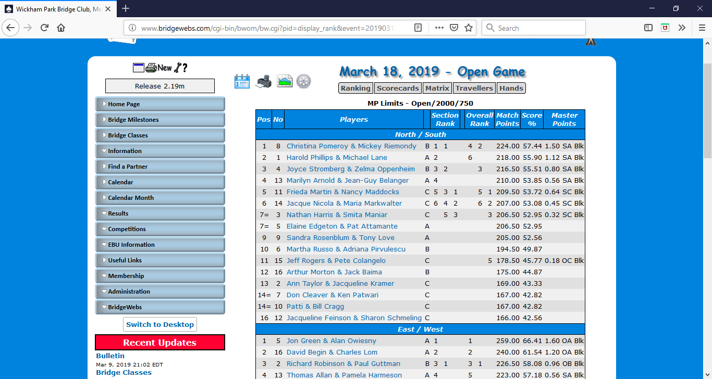

Slide 8
PLAY IT AGAIN
SELECT THE ENTRY FOR JON GREEN AND ALAN OWIESNY, THE FIRST ENTRY IN THE EAST/WEST SECTION.
THE FIRST SLIDE HIGHLIGHTS THE ENTRY THAT SHOULD BE SELECTED. THE SECOND SLIDE SHOWS WHAT APPEARS AFTER DOING SO.

Slide 9
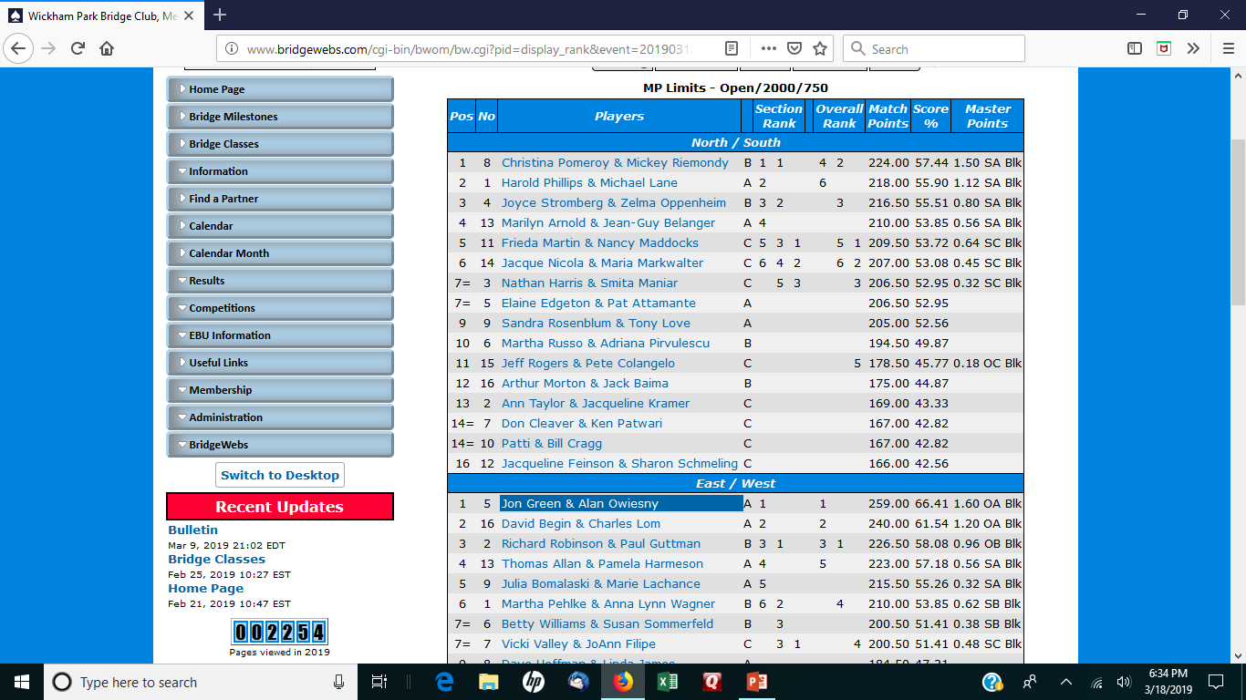

Slide 10
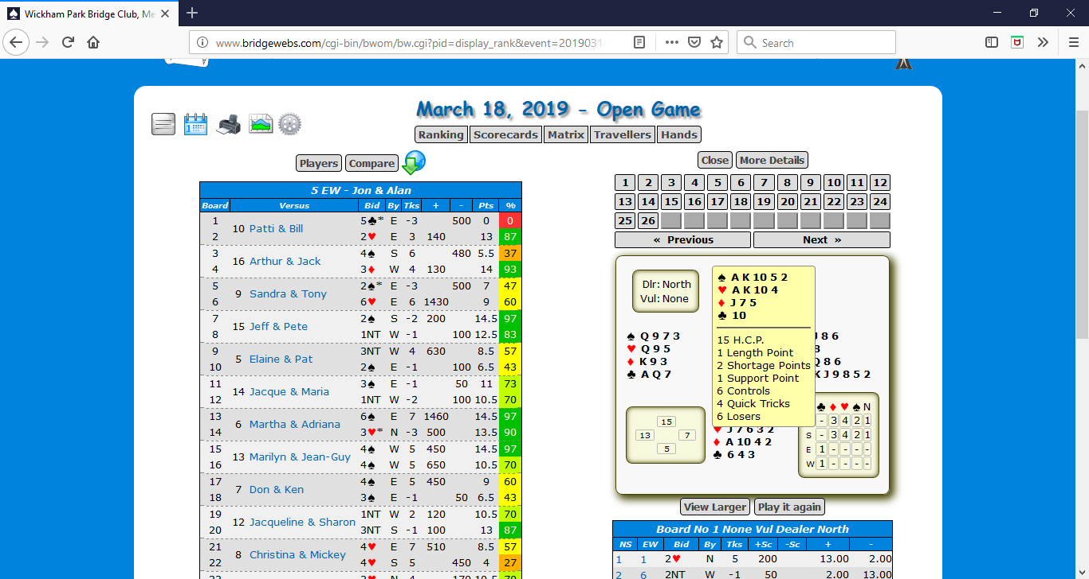

Slide 11
PLAY IT AGAIN
THE NEXT PAGE DEFAULTS TO BOARD 1. SELECT THE LINK FOR BOARD 13. YOU WILL NOTICE THAT THE BOARD NUMBER IS HIGHLIGHTED ON THE NEXT SCREEN PRINT.
THE SECOND SLIDE SHOWS THE ‘PLAY IT AGAIN’ BUTTON HIGHLIGHTED.

Slide 12
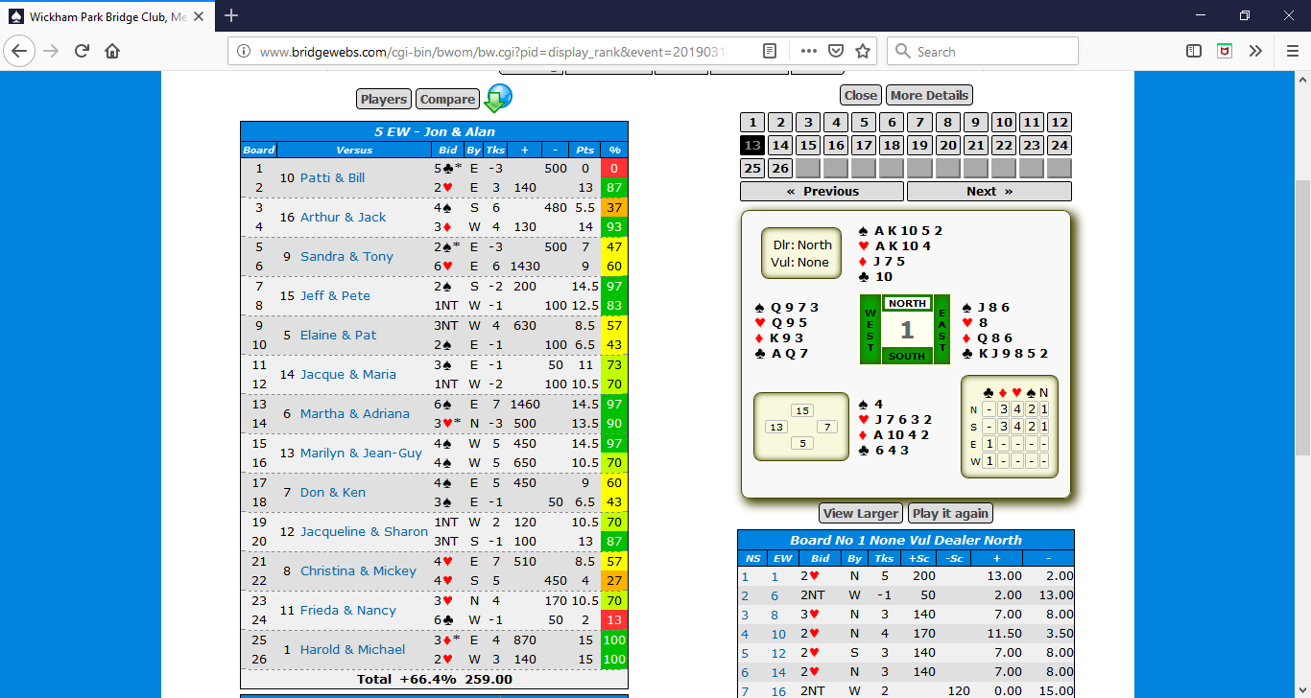

Slide 13
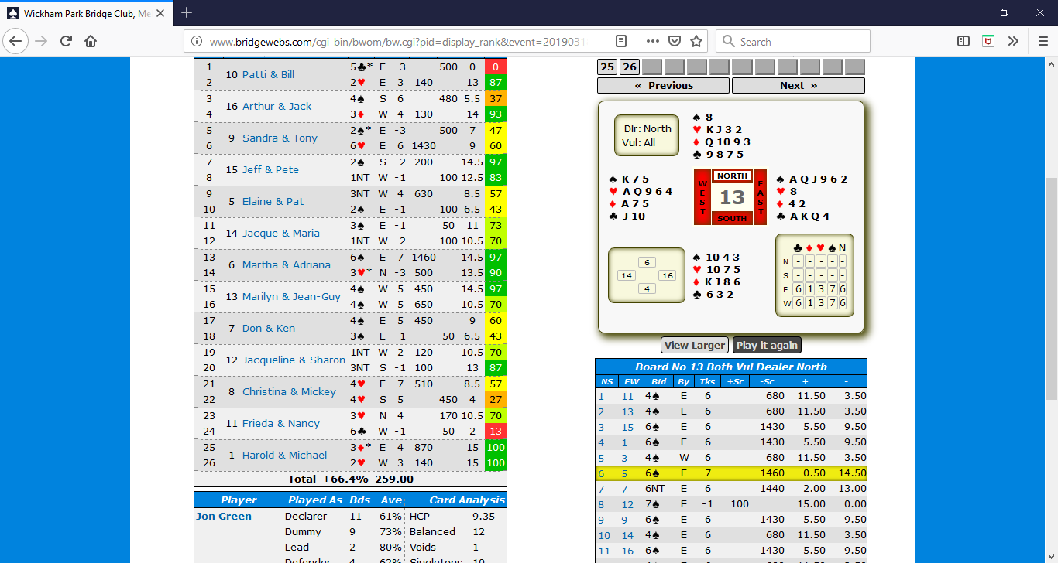

Slide 14
PLAY IT AGAIN
SELECT THE OPTION TO PLAY IT AGAIN. THE FIRST TIME YOU DO SO YOU MIGHT BE GIVEN AN OPTION TO SELECT A VIEWER. SELECT THE DEFAULT OPTION, BS ONLINE.
IT IS UNLIKELY THAT THIS PROMPT WILL OCCUR AGAIN.

Slide 15
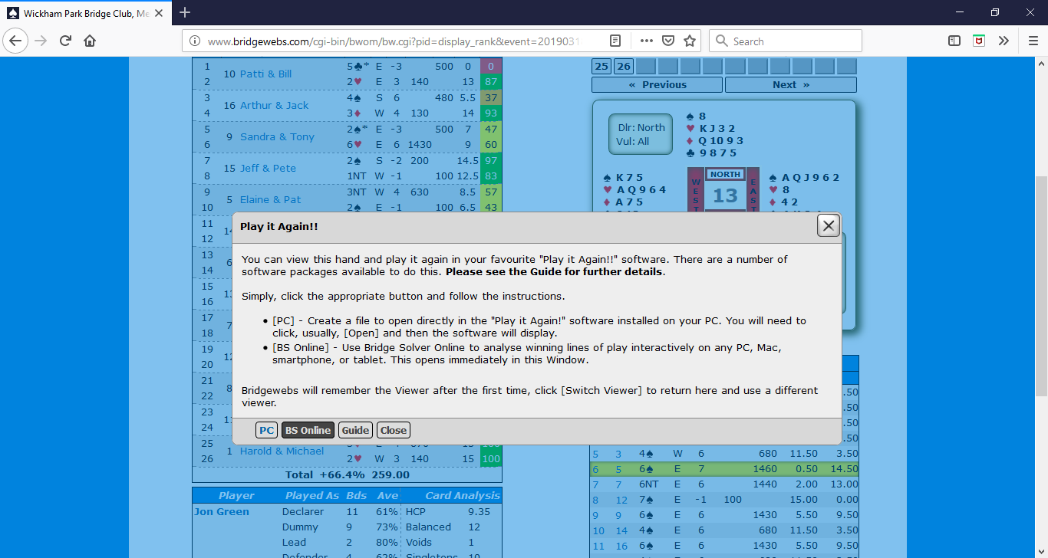

Slide 16
PLAY IT AGAIN
THE ‘PLAY IT AGAIN’ VIEWER HIGHLIGHTS THE MAXIMUM NUMBER OF TRICKS THAT CAN BE MADE IN YELLOW. IN THIS CASE, 7 SPADES CAN BE MADE WITH PROPER PLAY.
PRESS THE NUMBER 7 THAT IS HIGHLIGHTED TO START THE PLAY FEATURE FOR THIS CONTRACT. YOU CAN SELECT OTHER OPTIONS IF THE CONTRACT YOU REACHED IS DIFFERENT.

Slide 17
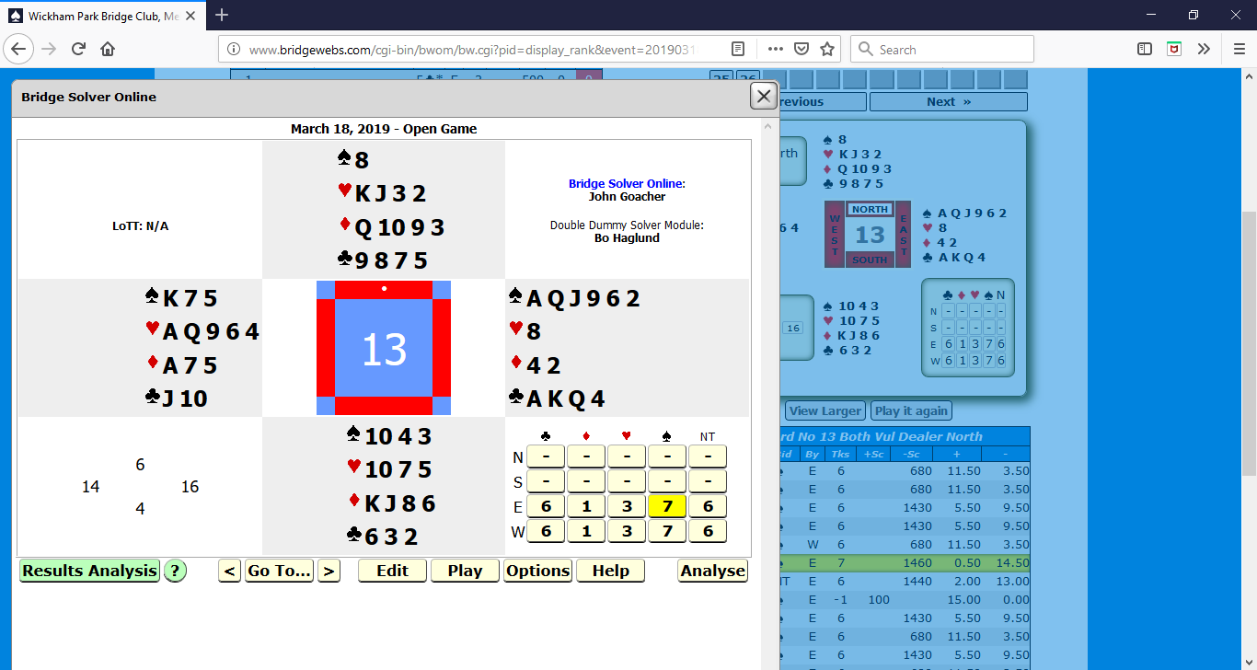

Slide 18
PLAY IT AGAIN
THIS SCREEN DEPICTS WHAT APPEARS AFTER PRESSING THE 7 OPTION, FOR THE CONTRACT 7 SPADES.

Slide 19
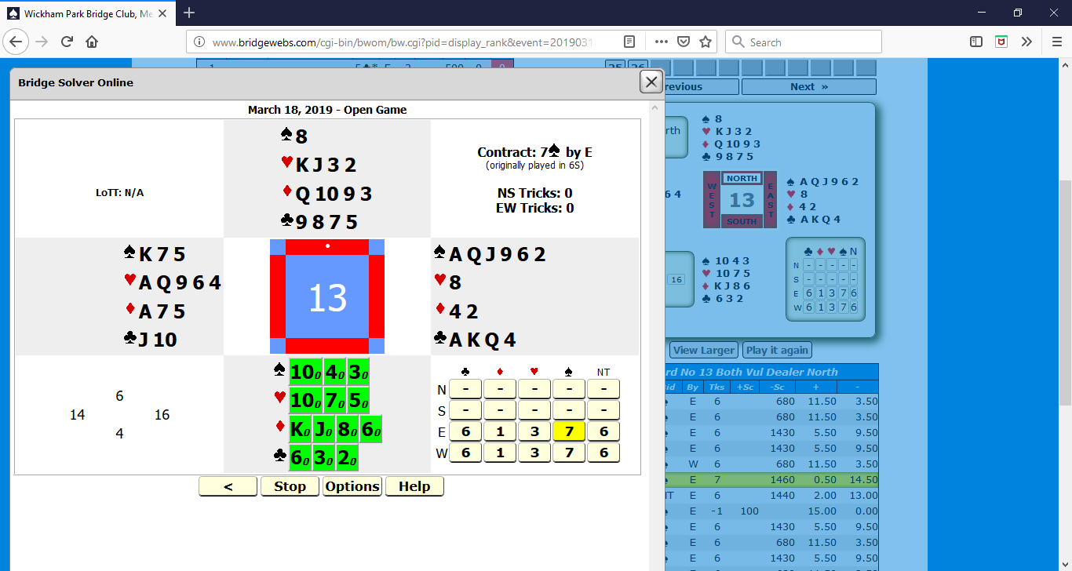

Slide 20
PLAY IT AGAIN
NOTICE THAT SOUTH HAS THE OPENING LEAD. THE SOUTH CARDS ARE HIGHTLIGHTED IN GREEN.
THERE IS A SUBSCRIPT NEXT TO EACH CARD. THIS INDICATES THE NUMBER OF TRICKS THAT DEFENCE CAN MAKE WITH EACH LEAD. IN THIS CASE, 7 SPADES CAN BE MADE, SO EVERY SUBSCRIPT IS ZERO.

Slide 21
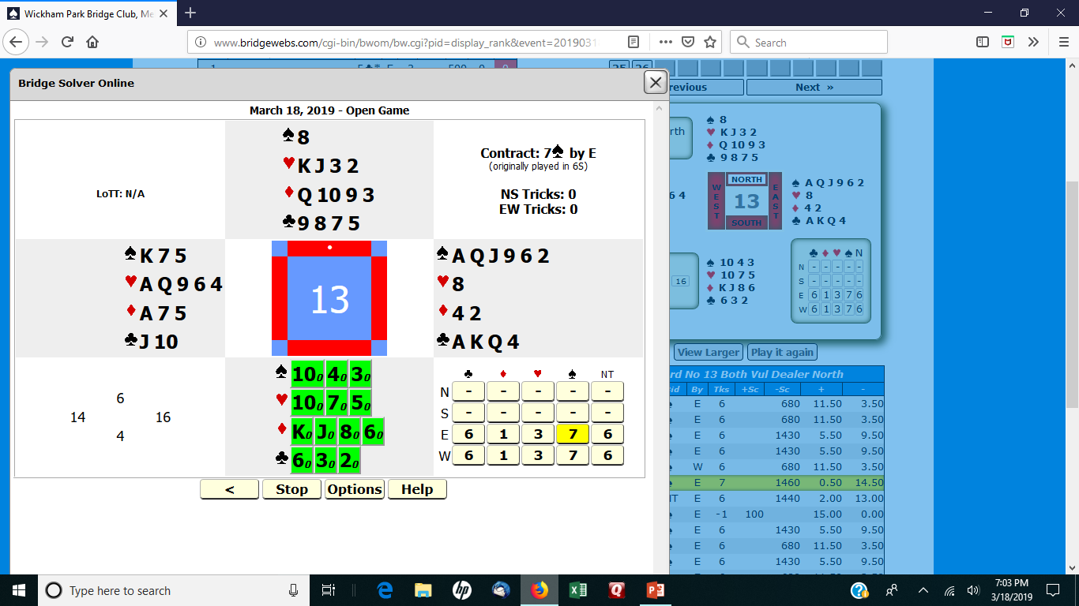

Slide 22
PLAY IT AGAIN
FOR DEMONSTRATION PURPOSES SELECT THE 6 OF CLUBS AS THE OPENING LEAD.
THE NEXT SLIDE NOW SHOWS THAT WEST IS GIVEN AN OPTION. WEST CAN PLAY THE JACK OR TEN OF CLUBS.
NOTICE THAT THE SUBSCRIPT FOR BOTH CARDS IS NOW 13. THIS MEANS THAT EAST/WEST CAN MAKE 13 TRICKS WITH EITHER CHOICE.
PRESS THE 10 OF CLUBS. NORTH NOW HAS AN OPTION, SHOWN IN THE SECOND SLIDE, FOLLOWED BY EAST’S OPTION.

Slide 23
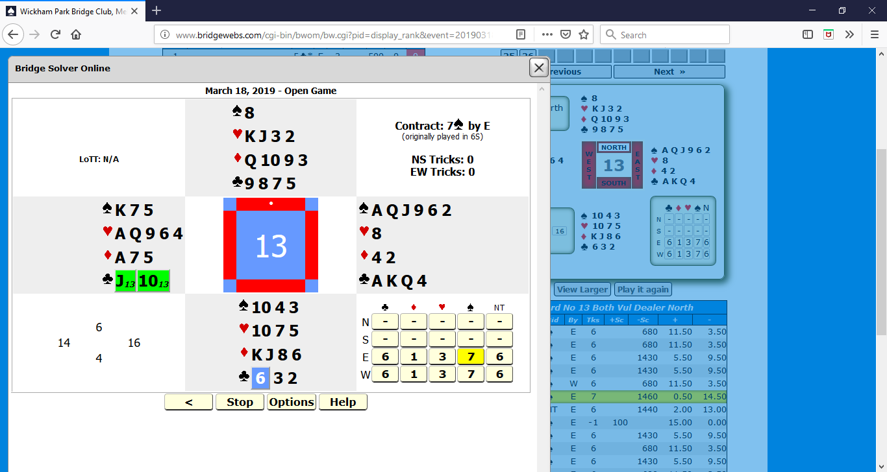

Slide 24
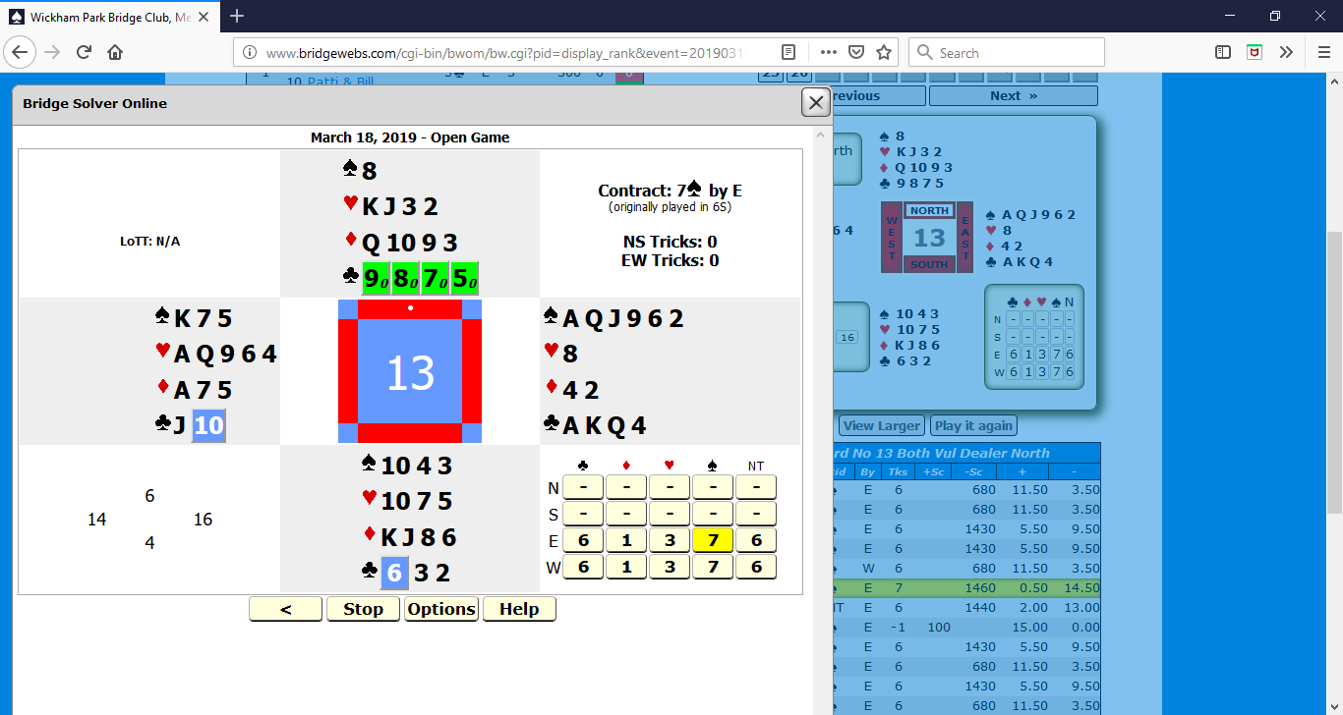

Slide 25
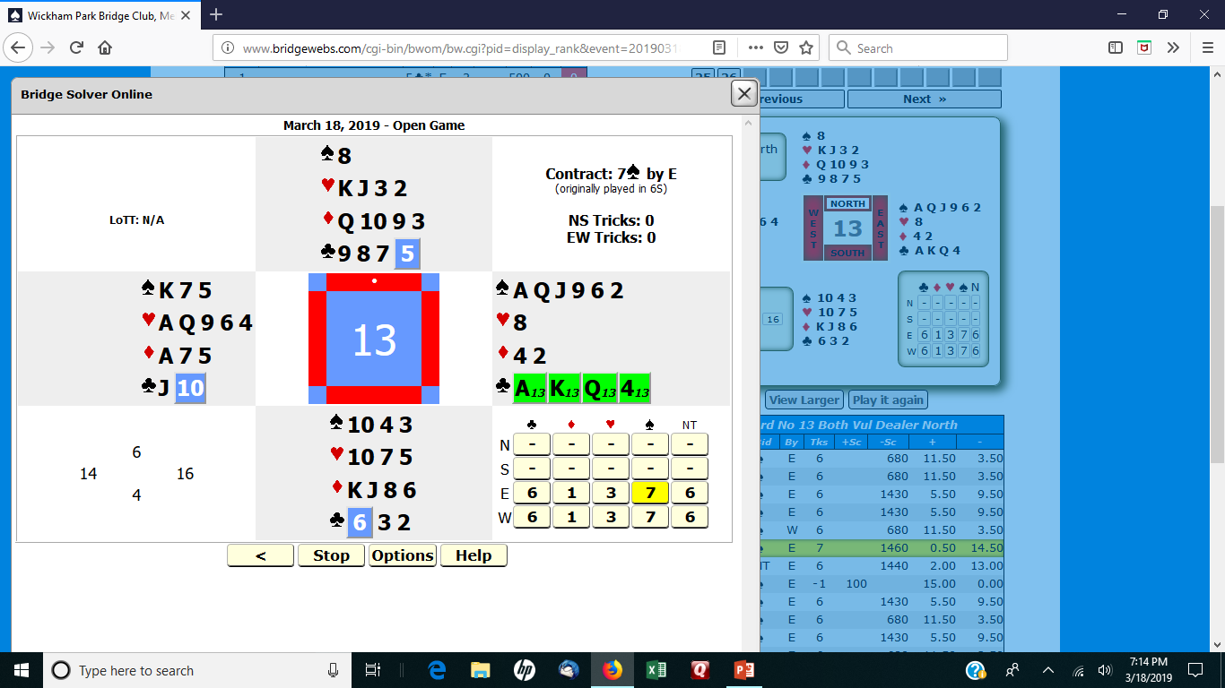

Slide 26
PLAY IT AGAIN
EAST PLAYS HIGH, SAVING AN ENTRY IN DUMMY. THE SLIDE SHOWS EAST’S OPTIONS. NOTICE THE ACE OF CLUBS IN THE BACKGROUND. IT HAS ALREADY BEEN PLAYED.
LEAD THE 8 OF HEARTS TO DUMMY’S ACE.

Slide 27
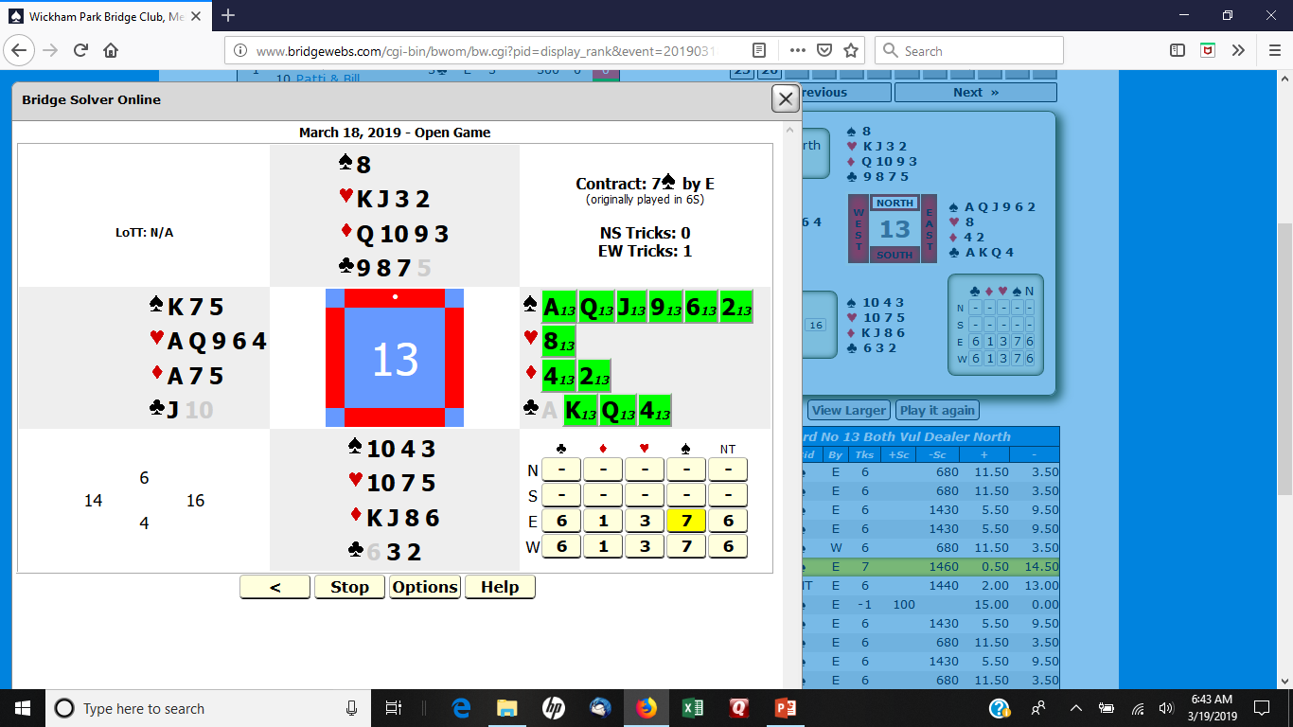

Slide 28
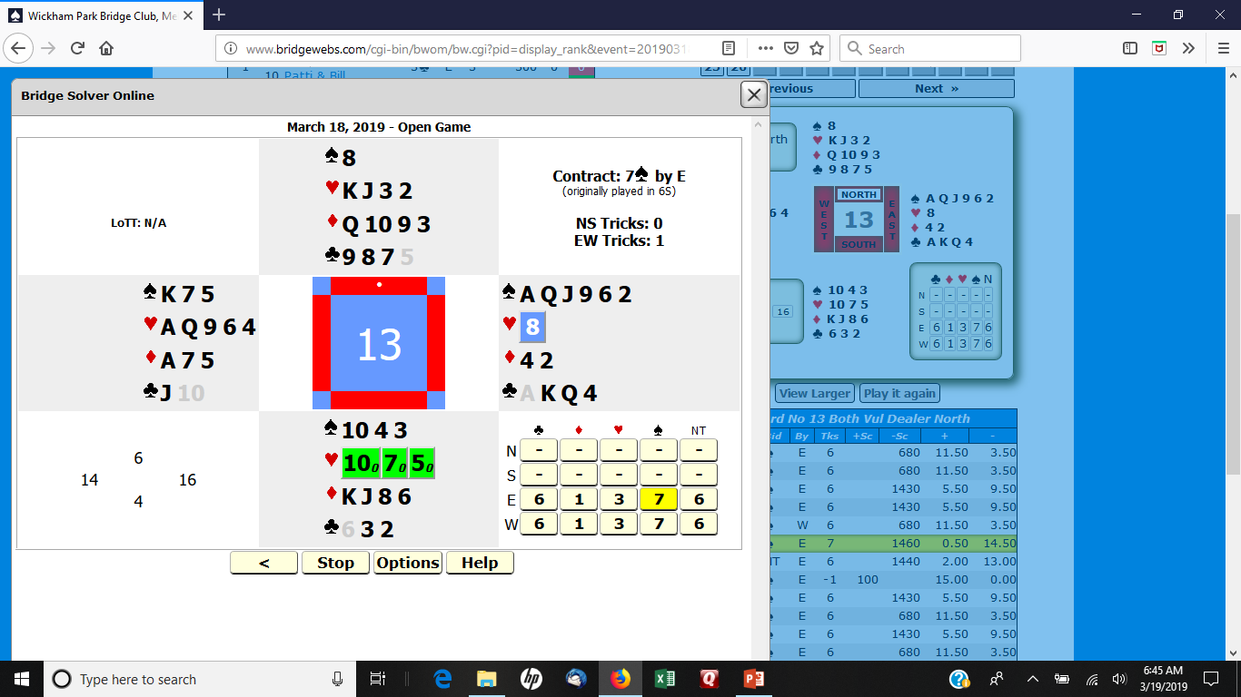

Slide 29
PLAY IT AGAIN
SEVERAL CARDS ARE HIGHLIGHTED IN GREEN AND SEVERAL ARE HIGHLIGHTED IN YELLOW. IF WEST LEADS ANY OF THE CARDS HIGHLIGHTED IN GREEN, 13 TRICKS CAN BE MADE. IF ANY OF THE YELLOW CARDS ARE LED, ONLY 12 TRICKS CAN BE MADE.
NOTICE THAT IF YOU PULL TRUMP AND THEN FINESSE THE QUEEN OF HEARTS, YOU MAKE 6 SPADES. THE OPTIMAL PLAY IS TO PLAY THE ACE OF HEARTS, RUFF A HEART, RETURN TO DUMMY WITH A TRUMP, RUFF ANOTHER HEART AND THEN PLAY A CLUB TO A JACK. NOW RUFF THE FOURTH HEART. THE FIFTH HEART IS ESTABLISHED. PLAY THE TWO HIGH SPADES TO REMOVE THE REMAINING TRUMP IN THE SOUTH HAND. CASH THE KING AND QUEEN OF CLUBS, PITCHING TWO DIAMONDS FROM THE DUMMY. PLAY A DIAMOND TO THE ACE AND DISCARD A DIAMOND ON THE QUEEN OF HEARTS.

Slide 30
PLAY IT AGAIN
THIS EXAMPLE SHOWS HOW THIS FEATURE CAN BE USED TO FIND THE OPTIMAL DEFENSE. WEST IS PLAYING 1 NOTRUMP. THIS SLIDE SHOWS WHAT APPEARS WHEN THE GAME IS REPLAYED.
NOTICE THAT THERE IS A DASH HIGHLIGHTED IN YELLOW IN THE GRID FOR 1 NOTRUMP WEST.

Slide 31
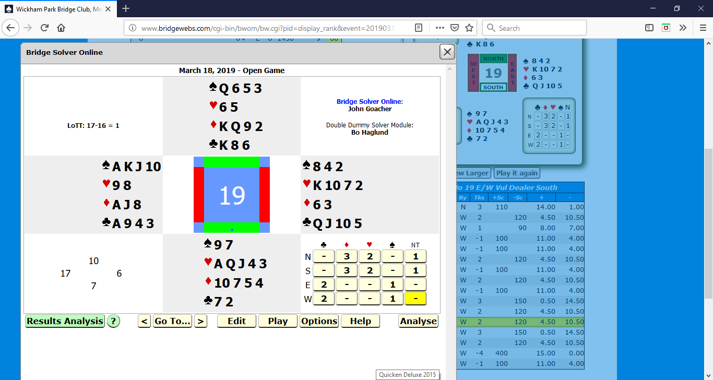

Slide 32
PLAY IT AGAIN
PRESS THE DASH TO START THE REPLAY.
THE OPTIONS FOR NORTH ARE HIGHLIGHTED IN GREEN AND YELLOW. OPENING LEADS OF ANY CARD THAT IS HIGHLIGHTED IN GREEN WILL ALLOW NORTH/SOUTH TO TAKE SEVEN TRICKS.
DANGEROUS LEADS ARE HIGHLIGHTED IN YELLOW. EVERY ONE OF THE OPENING LEADS WILL GIVE UP ONE OR TWO TRICKS.

Slide 33
