Slide 1
Weak Two Opening Hands
Colorado Front Range Bridge

Slide 2
Who started this?
It’s not new !
Harold Vanderbilt in 1925
Strong 2 bids are so rare, better
uses for 2D, 2H, 2S bids

Slide 3
Goals of Weak 2 Bid
Preempt the opponents, opening salvo
Burn up bid space
Make opponents guess
Suggest an opening lead
Ideally without damaging partner

Slide 4
Rules
Bridge teachers disagree
Classic writings disagree
It’s all about partnership
agreements

Slide 5
The Issues
Suit quality? Voids?
Suit length? Point range?
Outside aces? Vulnerability?
Other 4 card major? Team vs pair?
Who are the opponents?

Slide 6
Suit quality and length?
Conservative:
Must have 2 of top 3 honors
Always a 6 card suit
Aggressive:
Often only 1 honor
Might be 5 or 7 cards

Slide 7
Outside aces, voids
Conservative:
Often not discussed
Aggressive:
Not more than 1 singleton
No voids if partner has not bid

Slide 8
Other 4 card major
Conservative:
Often not discussed
Aggressive:
Reluctant if partner has not bid

Slide 9
Point range
Conservative:
6 to 11
Aggressive:
5 to ?

Slide 10
Vulnerability
Conservative:
Often not discussed
Aggressive:
Push if white on red

Slide 11
Recommedations
Tight rules mean fewer preempts
No “rules” means bad results
It all goes back to partnership
Agreements

Slide 12
Example 1
A Q x x x x
x x
J x x
x x
Example 2
x x
K Q J x x x
Q T x
x x
Example 3
Q T x
x
A J T x x x x
x x

Slide 13
Example 4
K Q T x x x
A x
void
Q J T x x
Example 5
A x
K J T x x x
x
Q T 9 8
Example 6
A Q T x x x
Q J x x x
x
x

Slide 14
What would Eddie do?
You are playing against Eddie Wold, #4 among active players. His partner opens 1C, your next to bid.
x x
x x
J T 9 8 7 4 3 2
A K

Slide 15
Responding to Weak 2 bids
Pause….time to evaluate
Pass?
Bid?
PASS

Slide 16
Responding to Weak 2 bids
The case for pass, the most likely response
Let the preempt do its job - obstruct
Bidding choices
Raise suit (not invitational)
Bid a new suit
Ask for more information

Slide 17
Raising partners weak 2
This is to play, not invitational
Opener should not bid again
Responder is now “captain”

Slide 18
Bid a new suit
Requires 13+ points
May be 5 card suit, but often 6+
RONF (raise only non forcing) or not?
partnership agreement, note on conv card

Slide 19
Asking for more info – bid 2NT
Typically responder has 15+ points
Choices
Feature?
Ogust?
RKC – not recommended

Slide 20
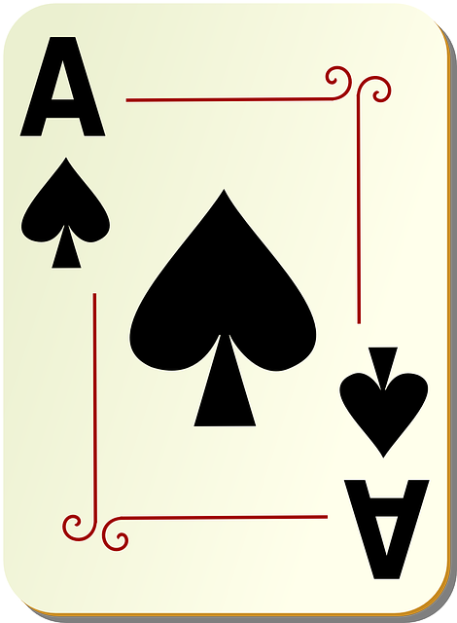
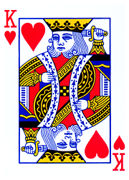
Feature
Responder is captain,
Feature is side suit Ace or King
Always show, or only if top of range?

Slide 21
Ogust – two answers in one
2C - “crap, crap”
2D - weak hand but good suit
2H - good hand, weak suit
2S - good hand, good suit
3N - specifically AKQxxx

Slide 22
Ogust – two answers in one
Good Suits:
A K x x x x
K Q x x x x
A Q x x x x
Good Hand:
Either top of range or 7 LTC

Slide 23
Ogust Responses
Example 7
Q x
A K x x x x
void
J x x x x
Example 8
Q J T x x x
x x
K J x
x x
Example 9
K J x
A Q J x x x
x x x
x
3S
Good, good
3C
Crap, crap
3D
Good suit, weak hand

