Slide 1
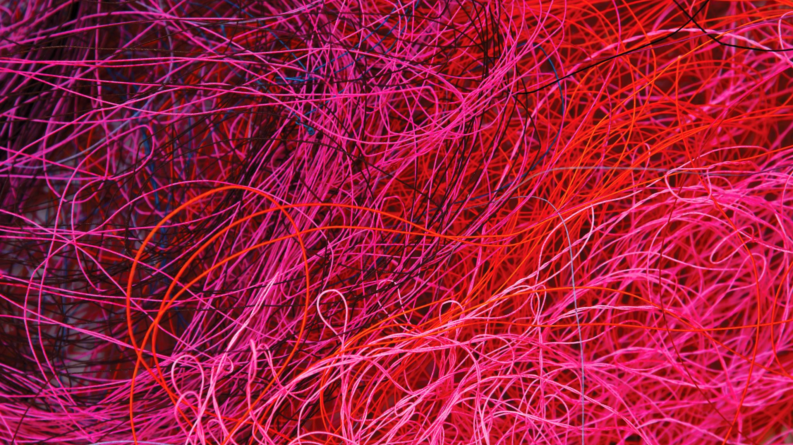
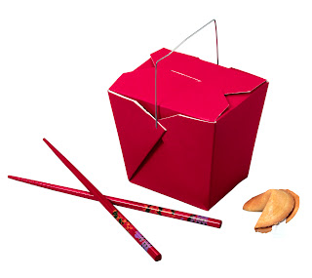
Takeout Doubles
Colorado Front Range Bridge

Slide 2
Lead Directing X
Takeout X
Responsive
X
Leightner X
Stolen Bid
Penalty
Card Showing
Do Something
X
Billy Miller
X
DOPI
DEPO
Support X
Single Suited Hand (over 1NT)

Slide 3
Takeout X
Low level double
In competitive auctions
Not for penalty !
Shows support for unbid suits
“No appropriate overcall”

Slide 4
1 Heart
Example 1
Q T x x
x
A J x x
K J x x
1 Diamond
1Heart
Example 2
A J x x
K J x x
-void-
Q x x x x
Example 3
A Q J
x x
K Q x x
K J T x
Your Bid? Takeout X in all three

Slide 5
Takeout X vs. Overcall
1 Heart
1 Diamond
Example 4
K x x
x x
Q J x x
A K J x x
Example 3
A Q J x x
J x x
K x
K J x
Overcall 2C
Overcall 1S

Slide 6
Types
After partner has bid, and opps overcall
Urging partner to get into auction
Big 18+ point hand exception
Pointing to two suits

Slide 7
Takeout X with BIG hands
1 Diamond
1 Heart
Example 5
A Q
A x
x x
A K J T x x x
Example 6
A Q T x x x
x x
A K J x
A
Hands too good to just overcall !

Slide 8
Responses to Takeout X
9 or fewer pts, bid best suit*
10+ jump one level*
Balanced hand and stopper
1NT with 8-10
2NT with 11-12
* Assumes opponents don’t bid before you

Slide 9
Responses to Takeout X
Opponents XX (redouble)
You MUST bid longest suit
Don’t make partner guess

Slide 10
Responses to Takeout X
The Rare Conversion
5 or 6 quality trumps
Other values

Slide 11
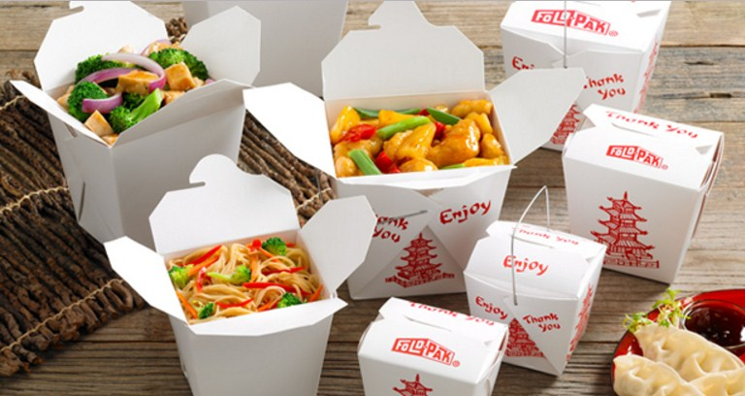
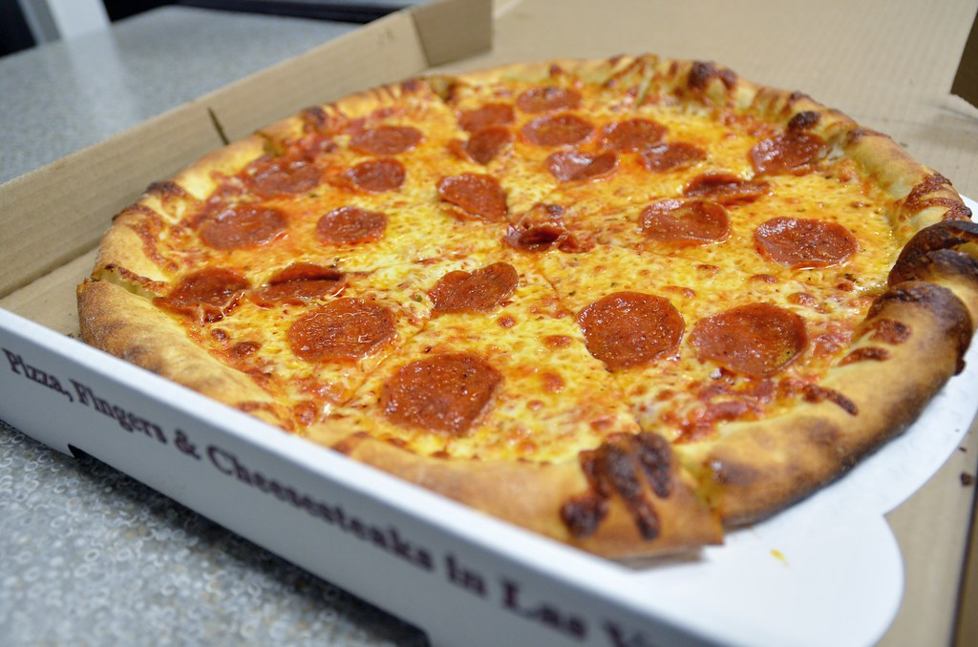
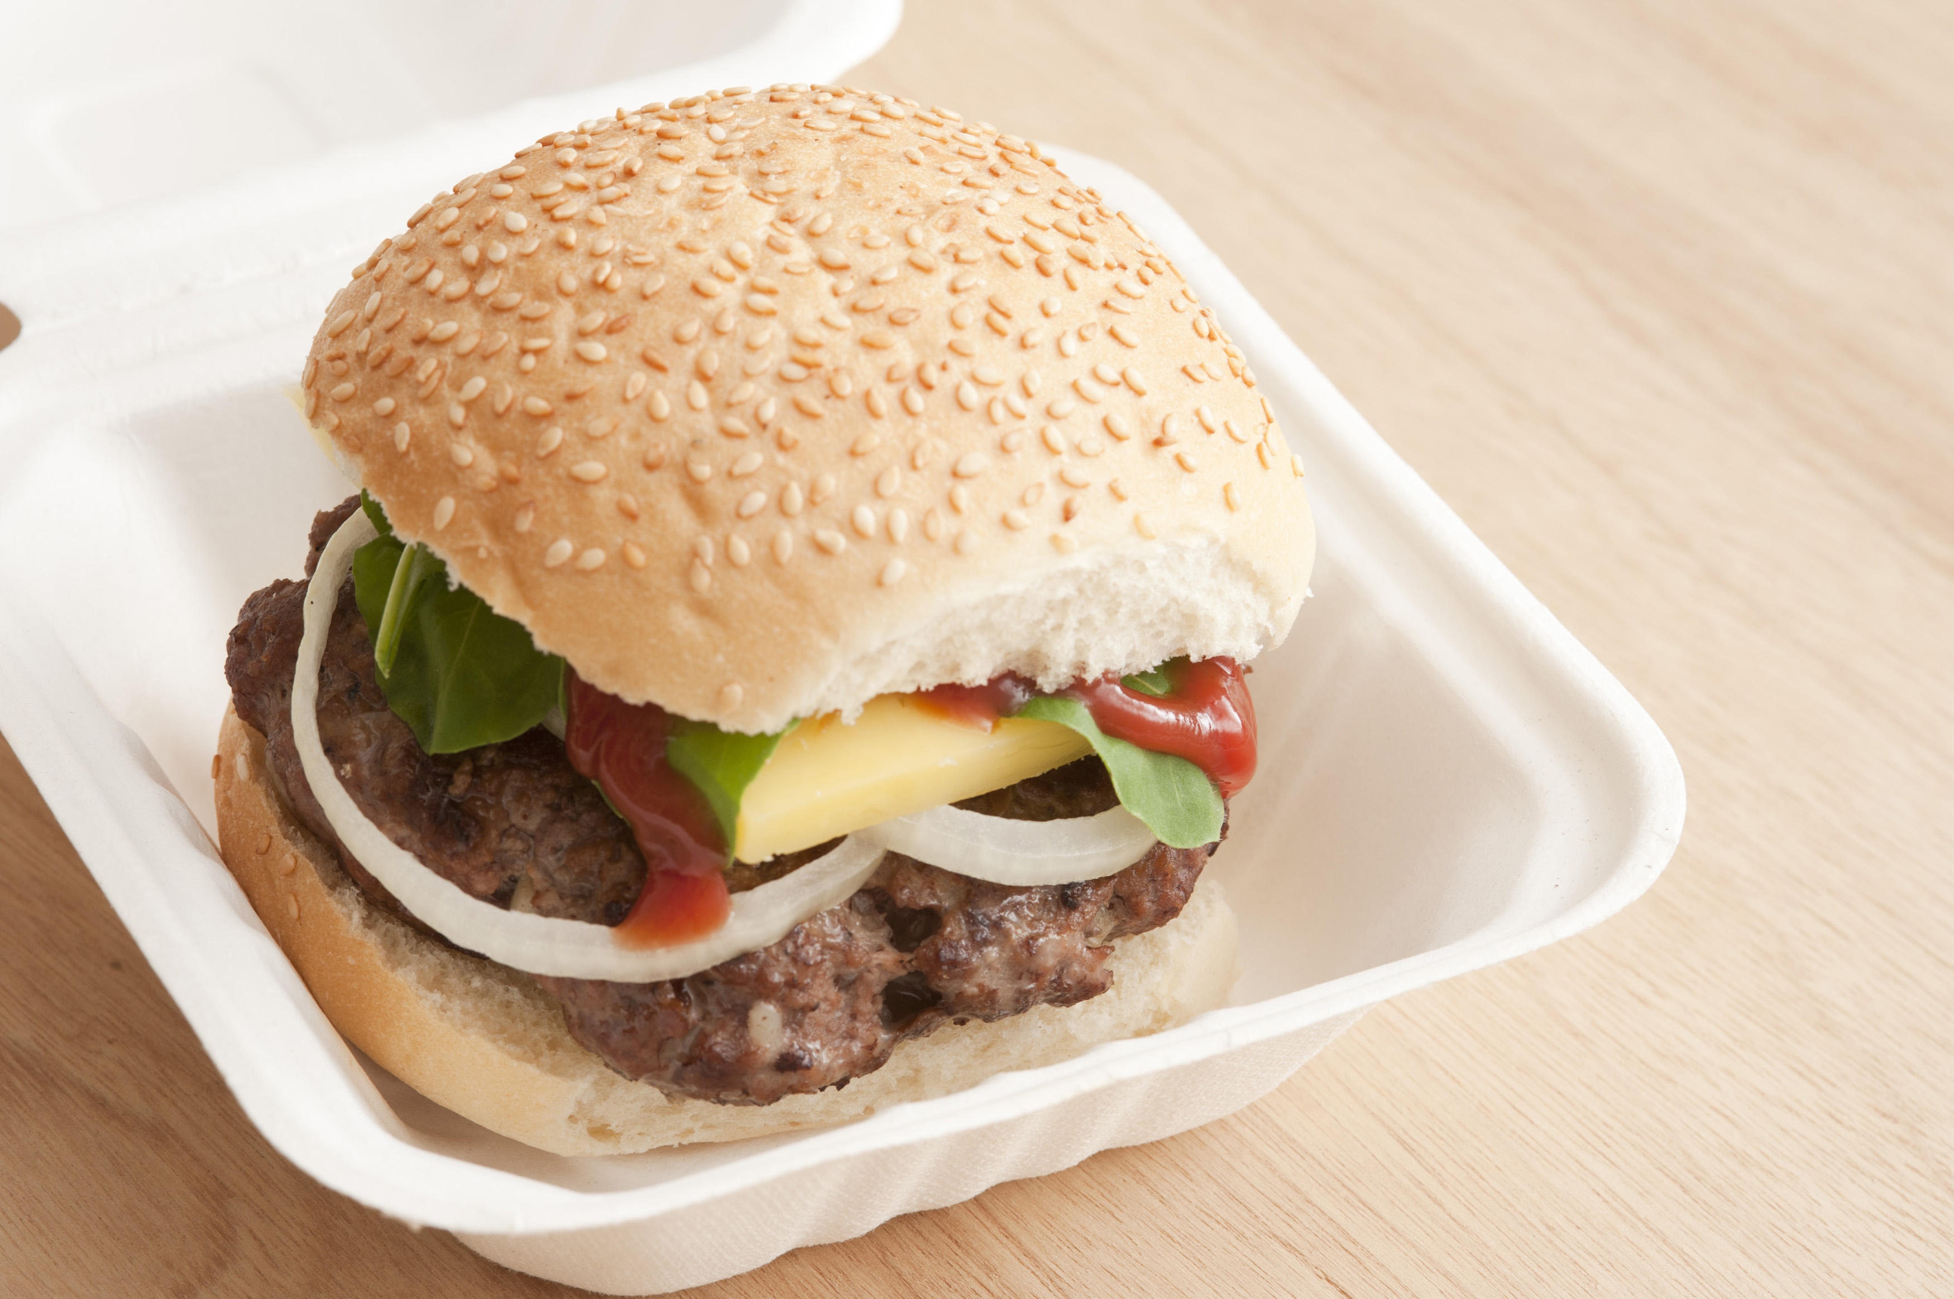
Next week – takeout doubles
This Photo by Unknown Author is licensed under CC BY-NC-ND

