Slide 1
Finesse
John Grossmann
Co Front Range Bridge

Slide 2
Sources of Extra Tricks
Ruff losers
Promotion
Length
Finesse
End play

Slide 3
Definition
A method of playing your cards to win a trick with a card lower than your opponent’s highest card!
You seek to take advantage of favorably placed honors.

Slide 4
Key Question
Trick one planning!
How many tricks do your need?
“Take All Your Chances” Eddie Kantor

Slide 5
Basic Finesse
A Q x x Lead to Queen 50/50
K Q x x x x Lead to K, repeat to Q
K x x x Lead to King, 50/50
Q x x A x x Cash ace, lead to Queen
K J x A x x Cash ace, lead to Jack

Slide 6
Double Finesse
A J T x x x x x
Lead to Jack
Cross back and lead to T
A Q T x x x
Lead to Ten, return and
Lead to Queen

Slide 7
High Card Finesse
A x x Q J T
Lead Q then J then Ten
Duck unless King shows
A J x x Q T 9 x
Lead Queen, then T, then 9
Duck unless King shows

Slide 8
Two Way Finesse
A T x K J x
K T 9 x A J x x
Does the bidding or
cards give a clue?
Try to get opponents to
break this suit.

Slide 9
Deep Finesse
A Q 9 x x x
If you need two tricks, desperate
measures are needed. Lead low
to nine, then lead to Queen

Slide 10
Odds of Success
50% One simple finesse
75% One of two finesses
25% Two of two
50% At least two of three
finesses

Slide 11
Good Habits
Don’t finesse because you know how, finesse with a purpose.
Make the finesse your last choice.

Slide 12
Example A xxx
AQ8
xxx
KQxx
QTxx Jxx
Jxxx T53
KTxx Axx
T Declarer Jxxx
AKx
Kxx
QJx Contract 3NT
Axxx Duce Spade Lead

Slide 13
Example B xx
AJTx
QJT
AQTx
Kxxx JTxxx
xx xx
Kxxx Ax
Kxx Declarer xxxx
AQ
KQxxx
xxxx Contract 4 H South
J9 Diamond Lead to A

Slide 14
Know the Math !
Your combined holding 8 cards
Opponents have 5
Odds of Suit Breaking
3-2 67.8 %
4-1 28.3
5-0 3.9
( More in handout )

Slide 15
Finesse vs 3/3 split?
Your combined holding is 7 cards
Opponents have 6, should you finesse ?
A K J x
x x x

Slide 16
Finesse vs 3/3 split?
Finesse is 50/50
3/3 split is 36%

Slide 17
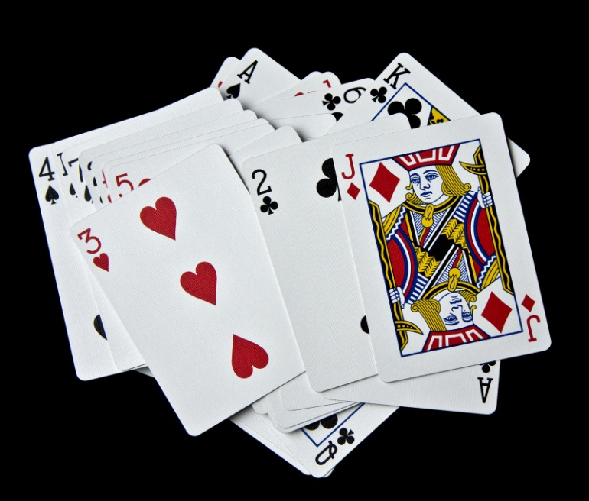
Practice Hands

